Slide 1
にほんご JPN101
Sep. 21, 2009
(Monday)

Slide 2
Characteristics of Japanese
Sentence types
Particles
Word order
Omission
Speech level

Slide 3
1. Sentence Types
A が(ga) B です(desu)。
A が(ga) B です(desu)。
A が(ga) Cます(masu)。
Noun
particle
Noun
Copula verb
Noun
particle
adjective
Copula verb
Noun
particle
verb

Slide 4
2. Particles
たなかさんは しょくどうで ともだちと
Tanaka-san wa shokudoo de tomodachi to
12じに ひるごはんを たべました。
12-ji ni hiru-gohan o tabemashita.
(Mr. Tanaka ate lunch with his friend at the cafeteria at 12 o’clock.)

Slide 5
3. Word order
It is SOV, but its order is flexible.
A cat caught a mouse.
A mouse caught a cat.
ねこが
Neko ga
ねずみを
Nezumi o
つかまえた。
Tsukamaeta.
ねずみを
Nezumi o
ねこが
Neko ga
つかまえた。
Tsukamaeta.

Slide 6
4. Omission
Elements which can be understood from the context and/or from the situation can be omitted (unless ellipsis makes the sentence ungrammatical).
X:やまださんは、きのう そのみせで なにをかいましたか。
X: Yamada-san wa kinoo sono mise de nani o kaimashita ka?
(What did Mr. Yamada buy at the store yesterday?)
Y: テレビをかいました。
Y: Terebi o kaimashita. (He bought a TV.)

Slide 7
5. Speech Level
Politeness and formality
Ex. たべる(taberu = to eat)
 | informal | formal
Regular | たべる taberu | たべます tabemasu
Polite (honorific) | めしあがる meshiagaru | めしあがります meshiagarimasu
Polite (humble) | いただく itadaku | いただきます itadakimasu

Slide 8
Japanese Sound System
Differences between Japanese and English
Articulation
Devoicing
Accent

Slide 9
1. Differences between Japanese and English
Japanese
Mora-timed language
Word accent assigned on morae
Mora = rhythmic unit
The length of mora is almost identical.
Ex. da.da.da.da……
Pitch change
English
Stress-timed language
Strong-weak beat alternation
Syllable = rhythmic unit
Ex. Dadada.Dadada.Da…
Intensity change

Slide 10
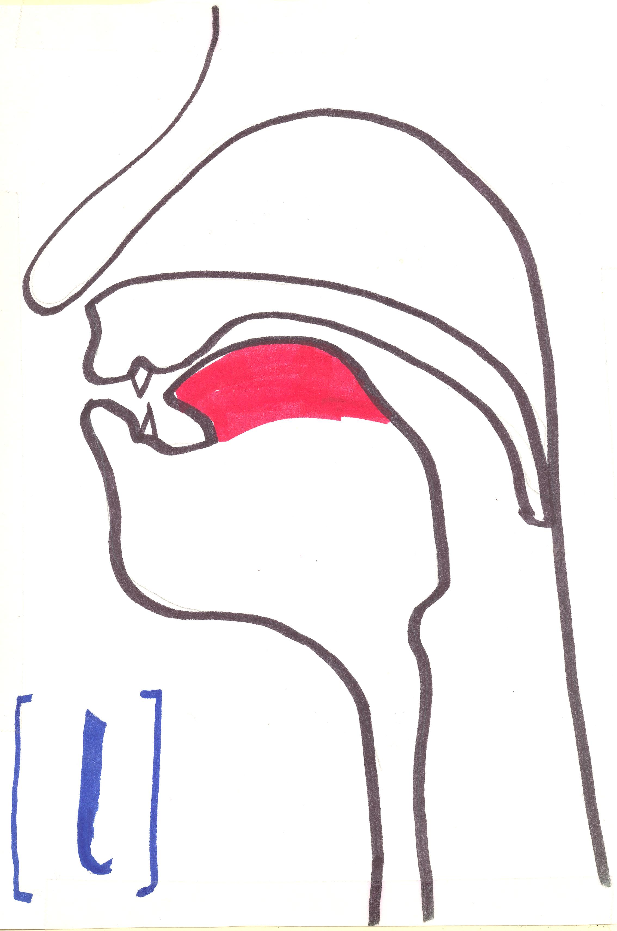
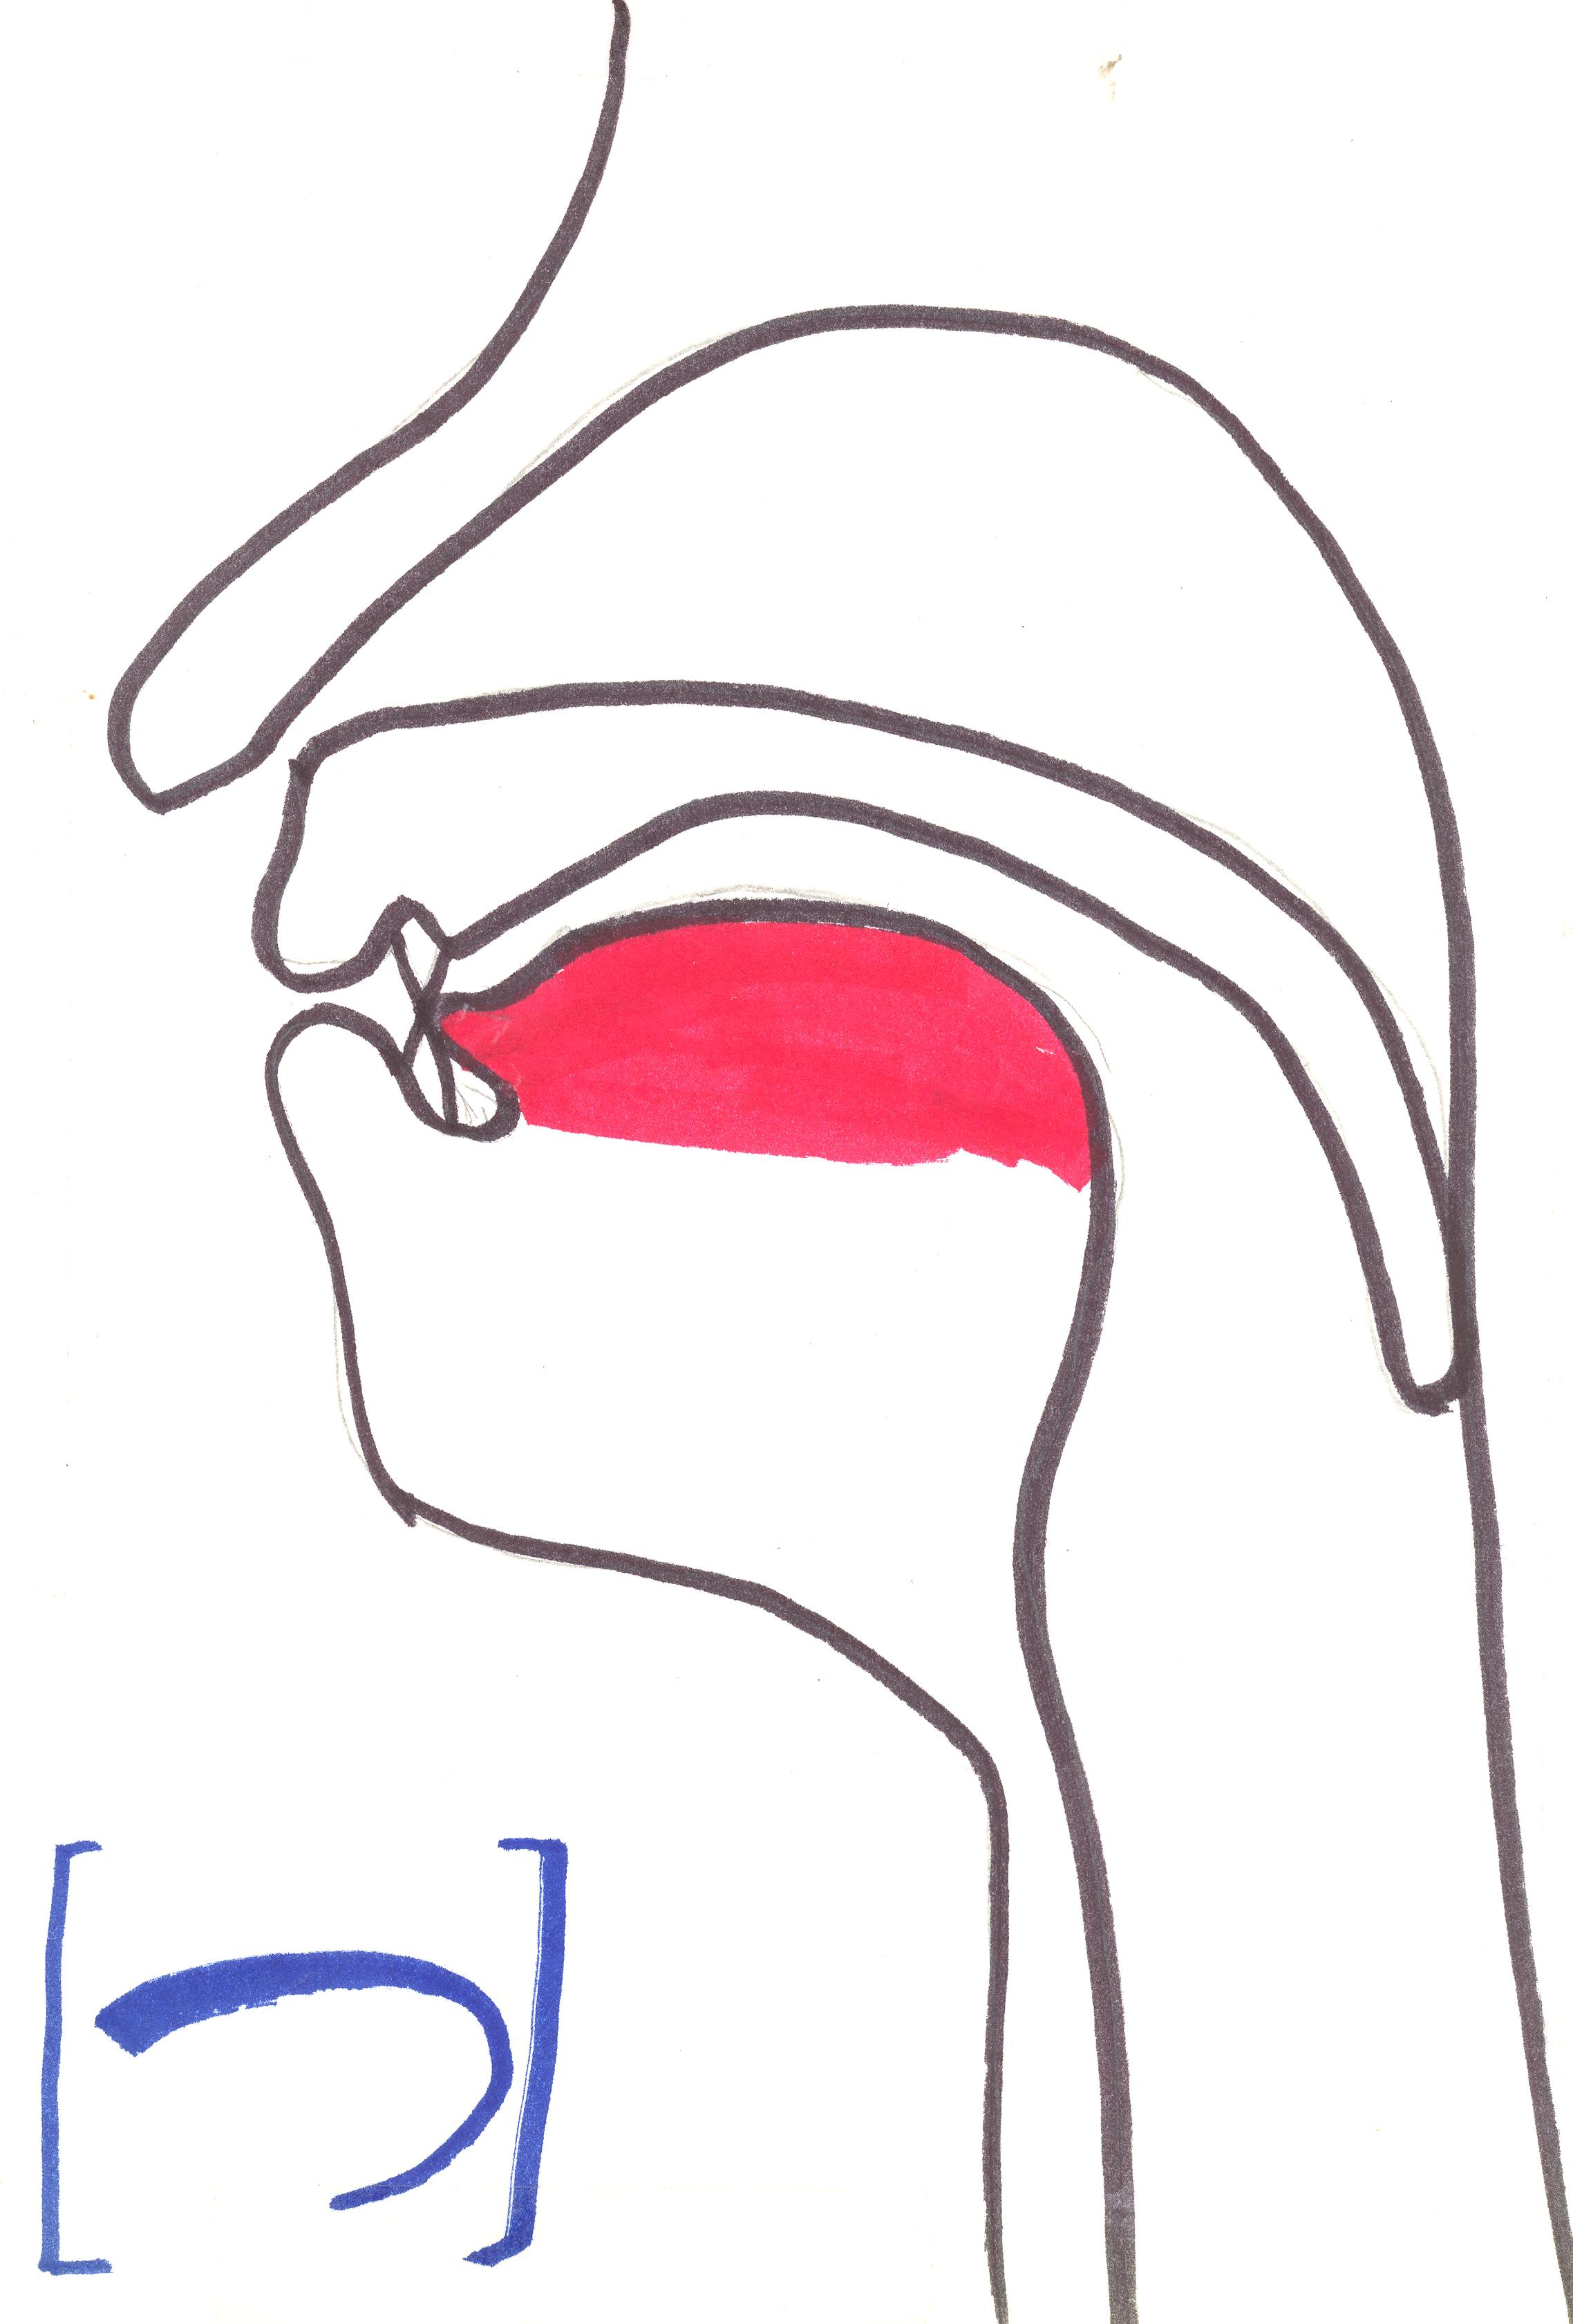
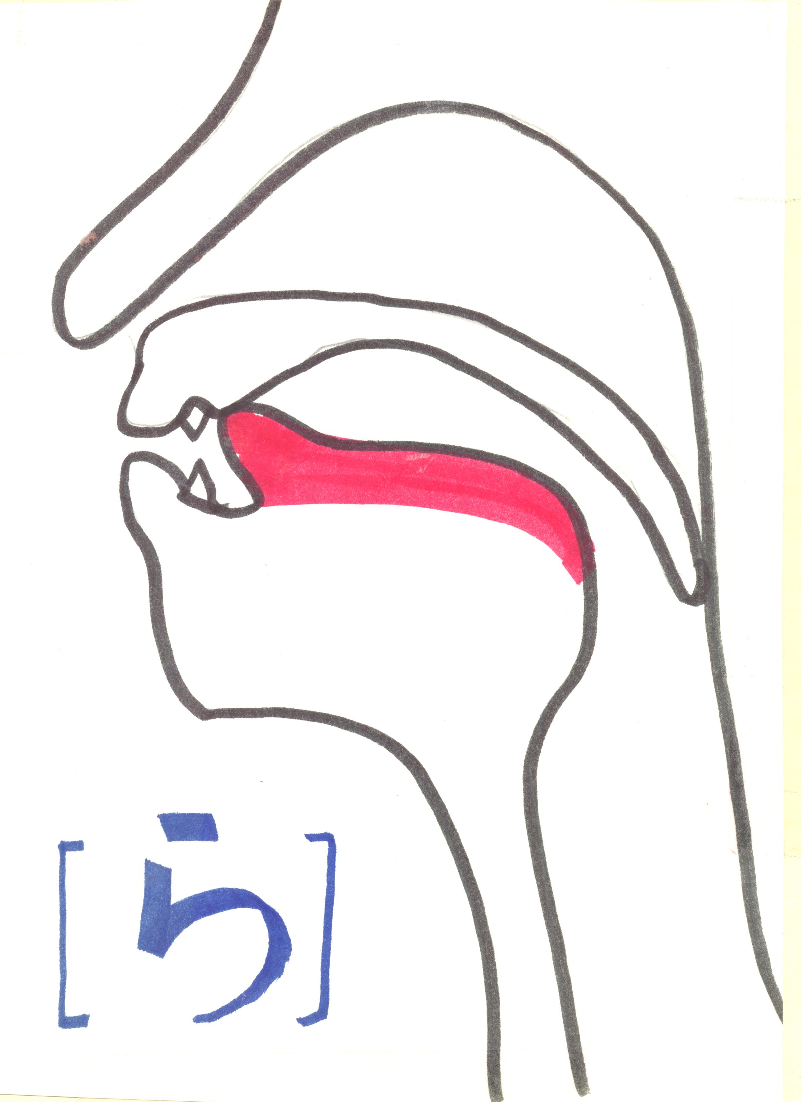
2. Articulation
Notes:
しkeep your lips spread out flat
ら flap the tongue forward quickly

Slide 11
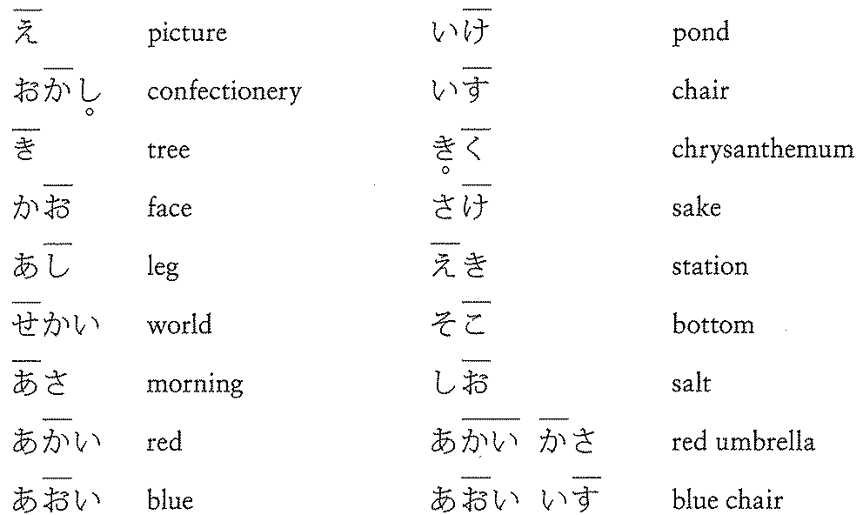
3. Devoicing

Slide 12
4. Accent
Click Japanese words to hear the pronunciation.
(Blackboard > JPN101 > Useful Web Links > Nakama1a Student Resources > Vocabulary)

Slide 13
Hiragana Chart (Textbook / p3)

Slide 14
ま～ん (Textbook / p13-15)

Slide 31
Pronunciation of ん
(1) ん is pronounced as [m] before [p], [b] and [m]
Examples：
[m] before [p]: かんぱ , しんぴ , にんぷ , かんぺき
[m] before [b]: がんばる, とんび, けんぶつ, せんべつ
[m] before [m]: あんま, しんみつ, にんむ, しんめ, ちんもく

Slide 32
Pronunciation of ん
(2) ん is pronounced as [n] before [t], [d], [n] and [r].
Examples:
[n] before [t]: しんたい, さんち, はんつき, こんてき, えんとつ
[n] before [d]: しんだい,とんじる, かんづめ, ぜんでら, こんど
[n] before [n]: こんなん, きんにく, せんぬき, ほんね, なんの
[n] before [r]: しんらい, げんり, ぶんるい, ぶんれつ, しんろ

Slide 33
Pronunciation of ん
(3) ん is pronounced as [ng] (like in English “sing”) before [k] and [g].
Examples:
[n] before [k]: さんか, てんき, もんく, こんけつ, きんこ
[n] before [g]: ふんがい, けんぎ, きんぐこんぐ, かんげい, ぶんご

Slide 34
Pronunciation of ん
(4) ん is pronounced as [N] (a nasal sound which is produced by bringing the back of the tongue in contact with the edge of the soft paate and making the air flow through the nose)
Examples：
ほん, にほん,あん,うん, ううん, えん, おん

Slide 35
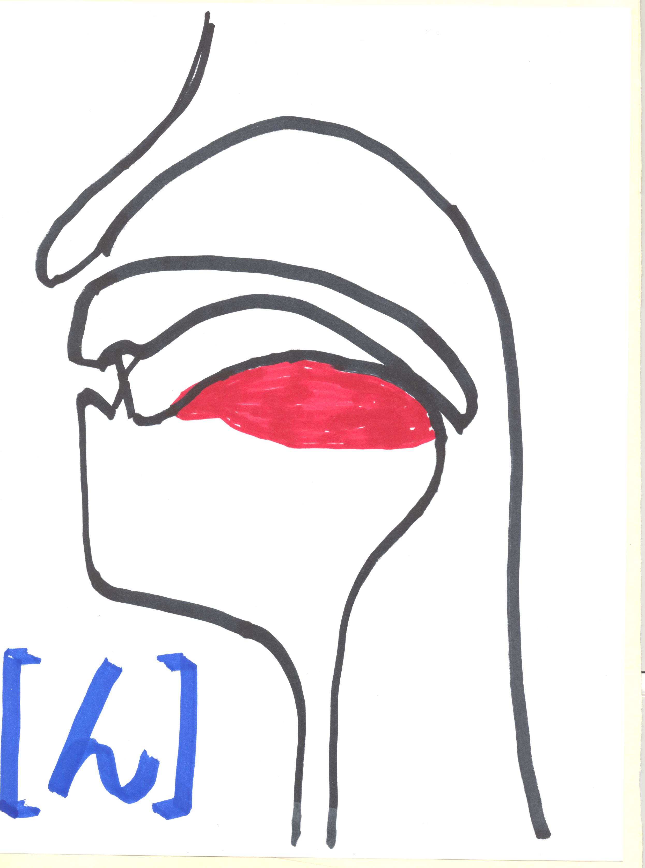
Articulation「ん」

Slide 36
Articulation「し」「つ」「ら」「ん」

