Slide 1
にほんご JPN101
Sep. 23, 2009
(Wednesday)

Slide 2
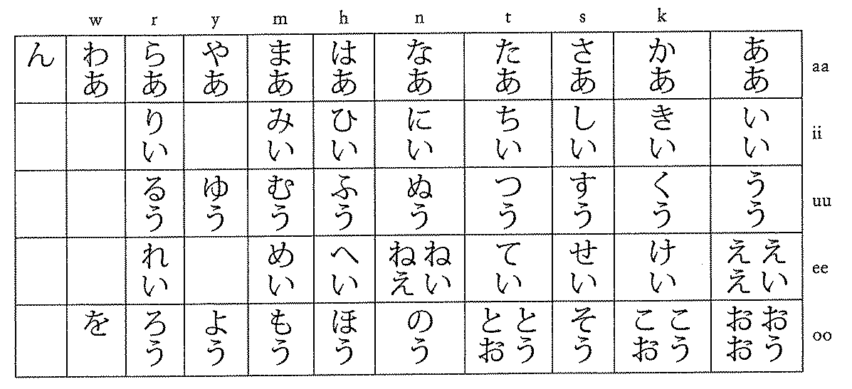
ああ～わあ Long vowels (Textbook p19-20)
When the same vowel appears twice consecutively in a word, the two are pronounced as a continuous sound rather than as two separate vowels.

Slide 3
ああ～わあ Long vowels (Textbook p19-20)
When い is added after the vowel [e] it is pronounced as [e].
ex. えいご eego
When う is added after the [o] sound, it is pronounced as [o].
ex. おとうさん otoosan
Here are some common exceptions that use え or お for long vowels.
ex. とおり こおり おねえさん

Slide 4
がくせい student

Slide 5
さとう sugar

Slide 6
とおり street

Slide 7
こうこう high school

Slide 8
とけい clock, watch

Slide 9
おおきい big, large

Slide 10
ちいさい small

Slide 11
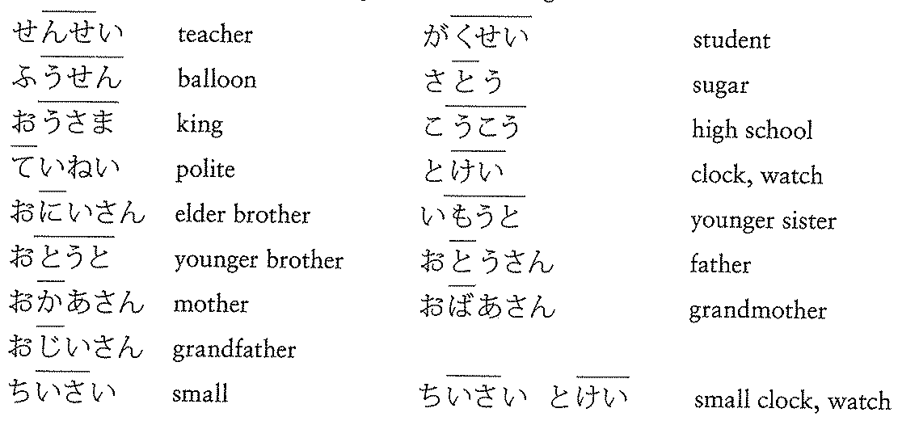
Reading hiragana (Textbook p20)
exceptions

Slide 12
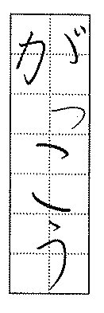
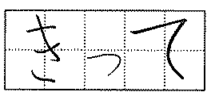
っ Double Consonants (Textbook p21)
Small っ indicates that the consonant that immediately follow it is preceded by a glottal stop and held for an additional syllable.

Slide 13
っ Double Consonants (Textbook p21)
kk ex. Nikki にっき(diary)
ss ex. Zasshi ざっし(magazine)
tt ex. Kitte きって(stamp)
pp ex. Kippu きっぷ(ticket)
dd ex. Beddo べっど(bed)

Slide 14
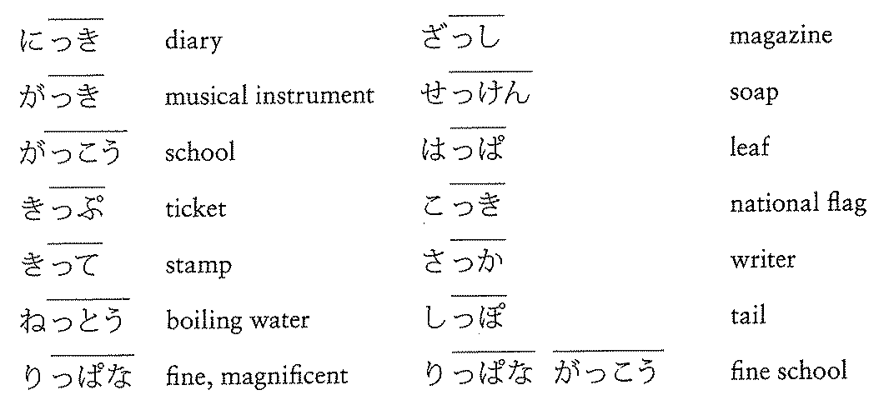
Reading hiragana (Textbook p21)

Slide 15
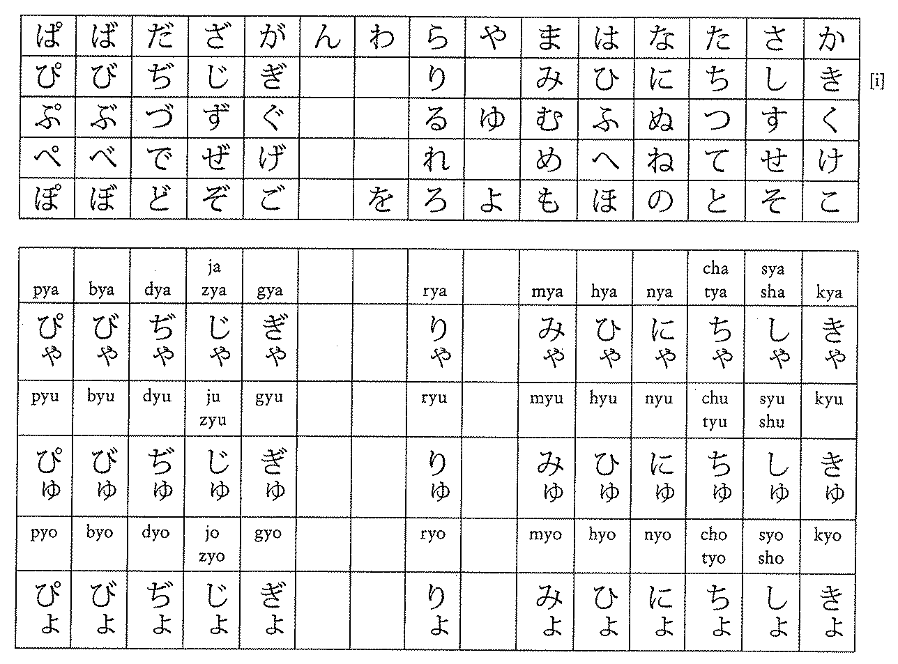
きゃ～ぴょ Glides (Textbook p24-25)
Sounds containing a consonant and [y], such as [kya], [kyu], or [kyo] are called glides. Glides are written with a hiragana containing the sound [i] followed by a small ゃ,ゅ, or ょ.

Slide 16
きゃ～ぴょ Glides (Textbook p24-25)

Slide 17
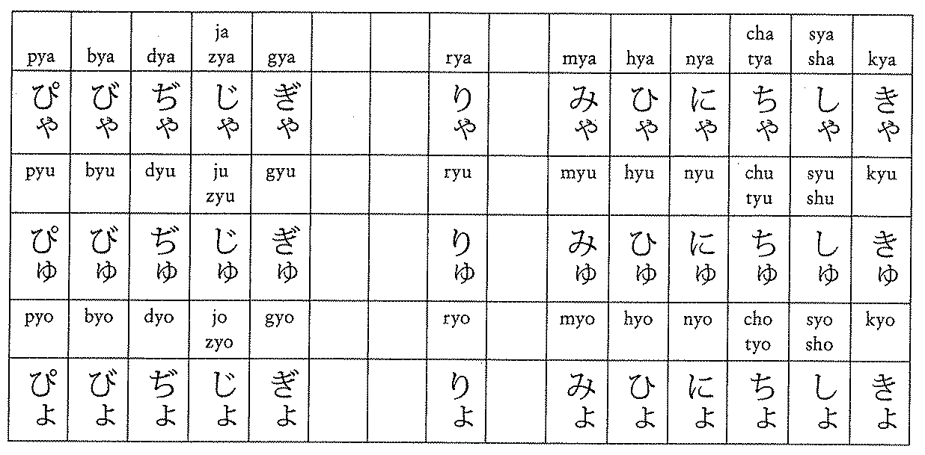
きゃ～ぴょ Glides (Textbook p24-25)

Slide 18
Reading Hiragana (Textbook p25)

Slide 19
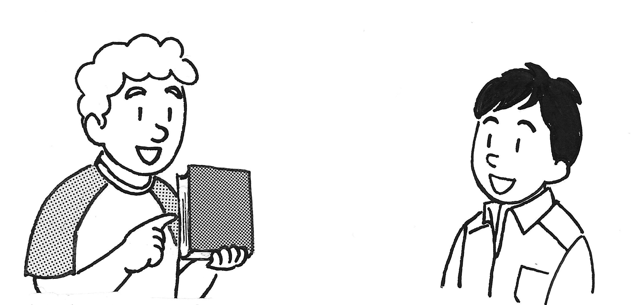
Asking for Japanese words and English Equivalents (Textbook p25-28)
Look at the objects in your classroom. Is there anything you do not know hot to say in Japanese?
Smith-san
Yamada-san

Slide 20
Asking for Japanese words and English Equivalents (Textbook p25-28)
Smith-san
Yamada-san
Smith: これは にほんごで なんといいますか。
What do you call this in Japanese?
Yamada: 「ほん」と／って いいます。
You call it hon.

Slide 21
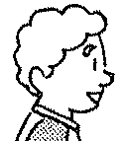
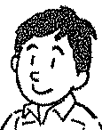
これ それ あれ If the object is …
Speaker
あれ
これ
それ

Slide 22
これ それ あれ
あのう、
～さん、
これ・それ・あれ
は
にほんご
で
なん
と
いいます
か。
XX
と
いいます。

Slide 23
Asking for Japanese words and English Equivalents (Textbook p25-28)
Smith-san
Yamada-san
Smith: これは にほんごで なんといいますか。
What do you call this in Japanese?
Yamada: 「ほん」と／って いいます。
You call it hon.

Slide 24
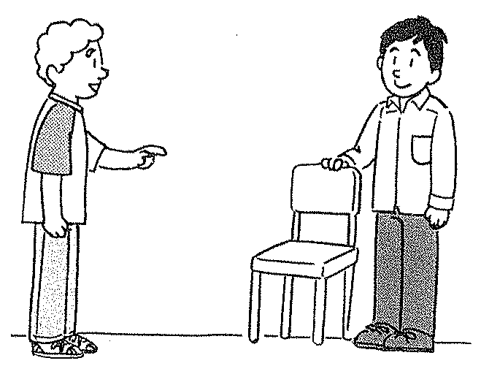
Asking for Japanese words and English Equivalents (Textbook p25-28)
Smith-san
Yamada-san
Smith: それは にほんごで なんといいますか。
What do you call that in Japanese?
Yamada: 「いす」と／って いいます。
You call it isu.

Slide 25
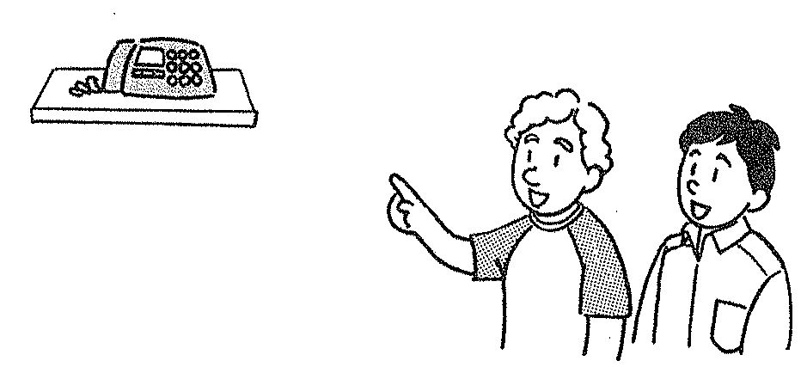
Asking for Japanese words and English Equivalents (Textbook p25-28)
Smith-san
Yamada-san
Smith: あれは にほんごで なんといいますか。
What do you call that (over there) in Japanese?
Yamada: 「でんわ」と／って いいます。
You call it denwa.

Slide 26
Asking for Japanese words and English Equivalents (Textbook p25-28)
If you want to know the Japanese word for an object that is out of sight, for something intangible, or for any English words …
English →Japanese

Slide 27
「love」は にほんごで なんと いいますか。
How do you say “love” in Japanese?
「あい」と／って いいます。
You say ai.

