Slide 1
にほんご JPN101
Oct. 12, 2009
(Monday)

Slide 2
１０月１２日月曜日
たんご (nouns, verbs, prefixes, suffixes)
ぶんぽう１（に、へ、を、で）
ぶんぽう２（～があります）

Slide 3
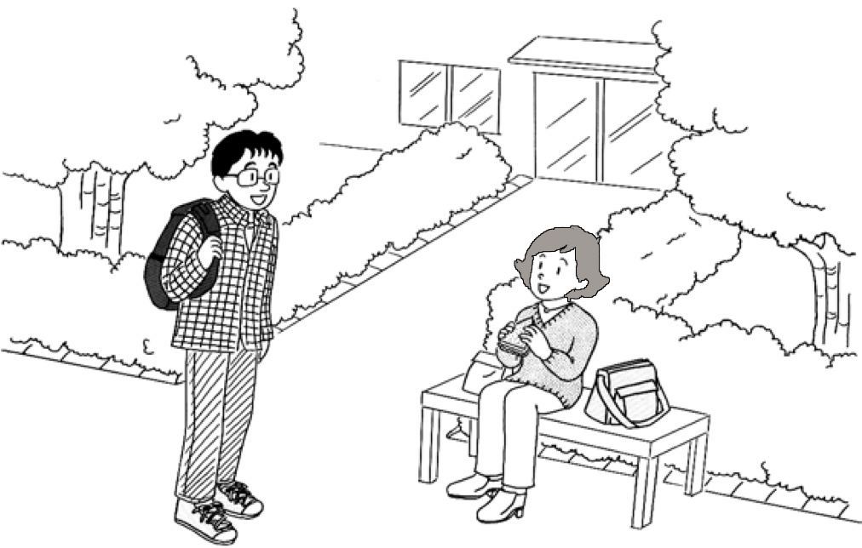
だいさんか まいにちの せいかつ Daily routines

Slide 4
たんご

Slide 5
たんご (p84-87)
Semantic Classification
Time Expressions
Days of the Week
Meals
Classification of Verbs (Polite Present)

Slide 6
1. Time Expressions (1)
あさ (morning)
ひる (day time，noon)
ばん (night, evening)
こんばん (tonight)
きょう (today)
きのう (yesterday)
あした (tomorrow)
おととい (the day before yesterday)
あさって (the day after tomorrow)
つぎ (next)

Slide 7
1. Time Expressions (2)
まいあさ (every morning)
まいにち (every day)
まいばん (every night),
まいしゅう(every week)
Notes: まい is a prefix that is attached to a time expression only.

Slide 8
2. Days of the Week (1)
Minor Phonetic Rule: If there is only one mora before – ようび, 「よ」 gets a high pitch. If not, the second and the third mora get a high pitch.
げつようび (Monday)
かようび (Tuesday)
すいようび (Wednesday)
もくようび (Thursday)
きんようび (Friday)
どようび (Saturday)
にちようび (Sunday).
Note: -ようび is a suffix attached only to げつ,か,すい,もく,きんand ど.
び of ようび often drops in conversation.]

Slide 9
2. Days of the Week (2)
こんしゅう (this week)
せんしゅう (last week)
しゅうまつ (weekend)

Slide 10
3. Meals
Minor Phonetic Rule: In compounds of X-ごはん the second mora of X and “ご”of “ごはん”get a high pitch.
ごはん (meal)
あさごはん (breakfast)
ひるごはん (lunch)
ばんごはん (dinner, supper)

Slide 11
4. Classification of Verbs (Polite Present)
U-Verbs, RU-Verbs and Irregular Verbs
Intransitive vs. Transitive Verbs
Phonetic Rule (#2)

Slide 12
4-A-1. う-verbs
The mora before –ます always ends in the vowel [i].
Examples: ari-masu, kaeri-masu, yomi-masu, etc.
あります
いきます
かえります
のみます
はいります
よみます

Slide 13
4-A-2. る-verbs
The mora before –ます usually ends in the vowel [e], but exceptionally it ends in [i].
Examples: tabe-masu (eat), ne-masu (go to sleep)
Exceptions: abi-masu (pour water over oneself), oki-masu (get up)
あびます
おきます
たべます
ねます
みます

Slide 14
4-A-3. Irregular verbs
きます (come to a place where s.o. (=someone) belongs),
します (do s.t.(=something).

Slide 15
4-B-1. Intransitive verbs
A verb which does not require a direct object. The action or state identified by the intransitive verb is related only to the subject of
the sentence. (← DBJG: p.6)
Examples: いきます，かえります，おきます，ねます，きます,etc.

Slide 16
4-B-2. Transitive Verbs
A verb that requires a direct object. It usually expresses an action that acts upon s.o. or s.t. indicated by the direct object. (← DBJG: p. 12)

Slide 17
Phonetic Rule 2 (1)
In all the masu-forms of verbs, all the morae except the first and the last mora get a high pitch. Therefore, the final [u] sound is devocalized.
Examples: あります (exist), はいります (enter), ねます (go to sleep), します (do)
If the verb is in the negative, i.e., -ません，the same phonetic rule applies.
Examples: いきません, かえりません, おきません,
しません，etc.

Slide 18
Phonetic Rule 2 (2)
If the verb is in the affirmative past tense, i.e., -ました, all the morae except the first and した get a high pitch. Therefore the final [a] is devoiced.
Examples：いきました, かえりました, おきました, しました，etc.
If the verb is in the negative past tense, i.e., -ませんでした，all the morae except the first and んでした get a high pitch.
Examples: いきませんでした，かえりませんでした，
おきませんでした，しませんでした，etc.

Slide 19
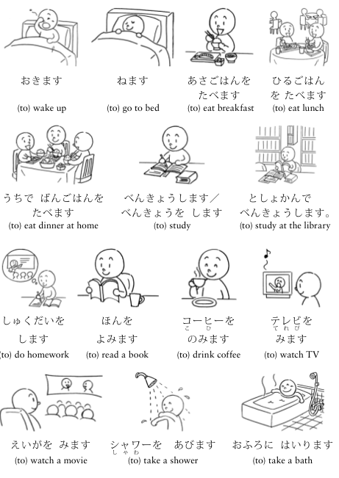
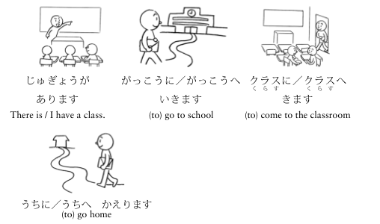
たんごの れんしゅう (p88-89)

Slide 20
ぶんぽう

Slide 21
ぶんぽう1： Talking about routines, future actions or events using the polite present form of verbs and the particles に,へ,を,で
Polite present form of verbs
Direct object particle, を
Destination or goal particles に and へ
Place of action and event, で

Slide 22
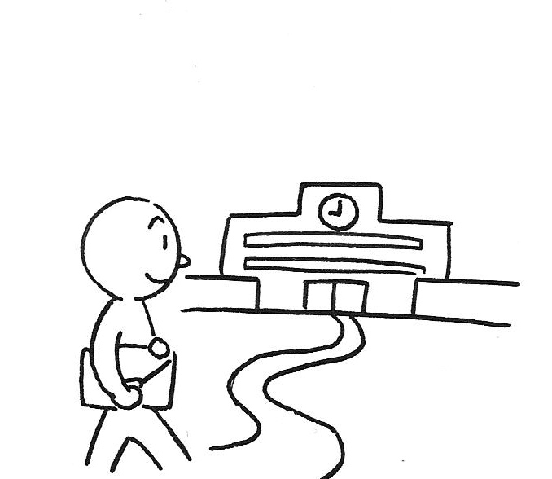
A. Polite present from of verbs Verb tenses

Slide 23
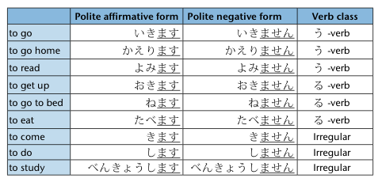
A. Polite present from of verbs Verb classes

Slide 24
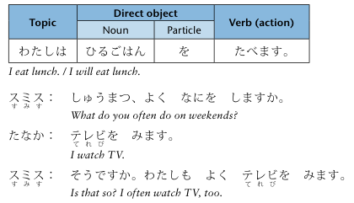
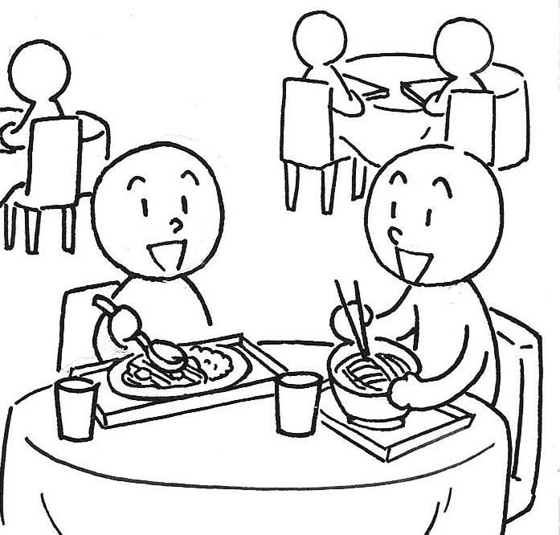
B. Direct object particle, を

Slide 25
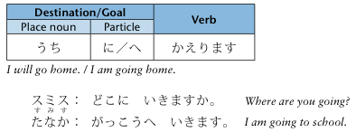
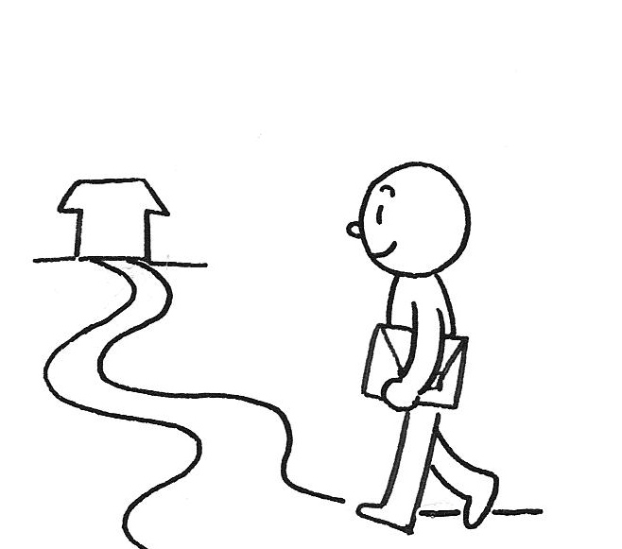
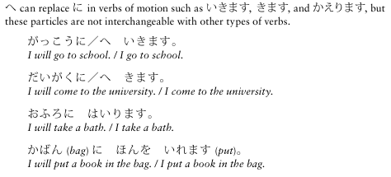
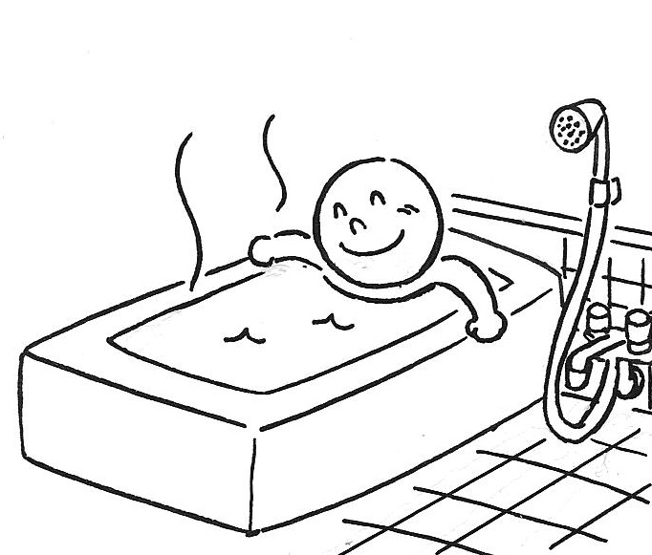
C. Destination or goal particles に and へ

Slide 26
C. Destination or goal particles に and へ
きます vs. いきます
If a movement is towards a place where the speaker can place his viewpoint, きます is used, but if a movement is towards a place where the speaker cannot place his viewpoint, いきます is used.
いきます vs. かえります
When someone goes to his own “home base” (e.g., うち ‘home’), うちにいきます is ungrammatical. In this case, かえります ‘return’ is used as in うちにかえります ‘go home’.

Slide 27
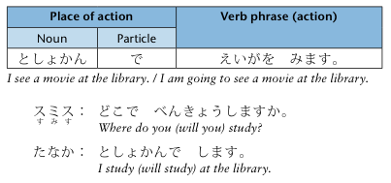
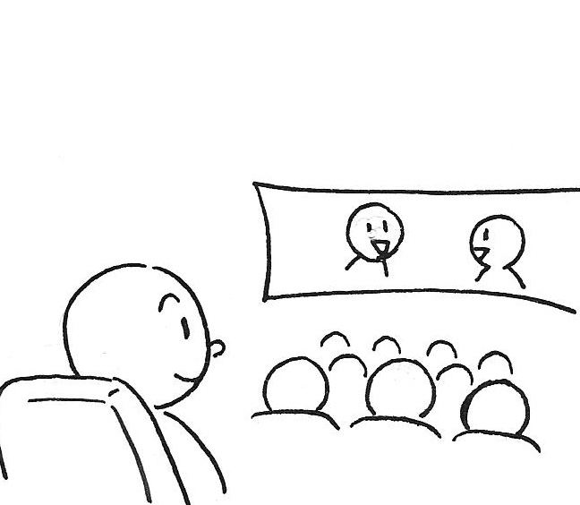
D. Place of action and event, で

Slide 28
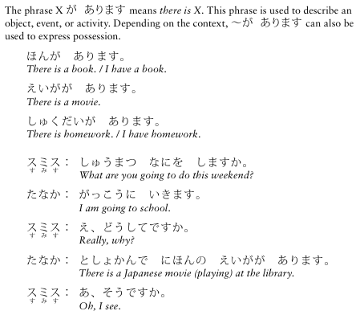
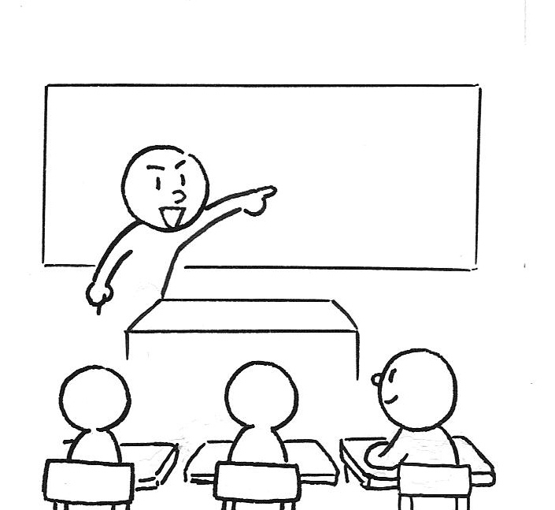
ぶんぽう2：Presenting objects or events using ～があります

Slide 29
ぶんぽう2：Presenting objects or events using ～があります

