Slide 1
にほんご JPN101
Oct. 14, 2009
(Wednesday)

Slide 2
１０月１４日水曜日
たんご (numbers, counter)
ぶんぽう３（に）
ぶんぽう４（to express frequency of actions）
ぷんぽう５（polite past forms of verbs）

Slide 3
たんご

Slide 4
Numbers (p91)

Slide 5
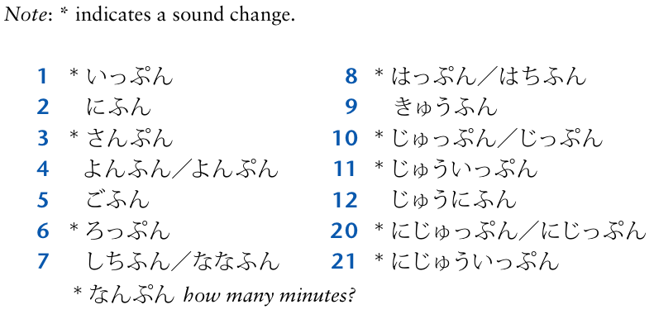
Minute(s) (p93)

Slide 6
Minute(s) (p93)
Minor Phonetic Rule
When a number takes a suffix ふん(minute)，a high pitch falls on the first mora, if
the number is 1 through 10, except 7 (しちふん/ななふん) and 8 (はちふん) ．
Examples: いっぷん, にふん, さんぷん,よんふん/よんぷん, ごふん, ろっぷん,
はっぷん/はちふん, きゅうふん, and じゅっぷん/じっぷん.
If the number is 20, 30, 40, and 50, a high pitch falls on morae except the first
mora and ふん or ぷん.
Examples: にじゅっぷん, さんじゅっぷん, よんじゅっぷん, ごじゅっぷん
If the number is compound like にじゅういっぷん, にじゅうにふん, and so on,
there are two high pitches, keeping the original accent intact.
Examples: にじゅういっぷん, にじゅうにふん, にじゅうさんぷん,
にじゅうよんぷん, にじゅうごふん, にじゅうろっぷん, にじゅうしちふん，etc.

Slide 7
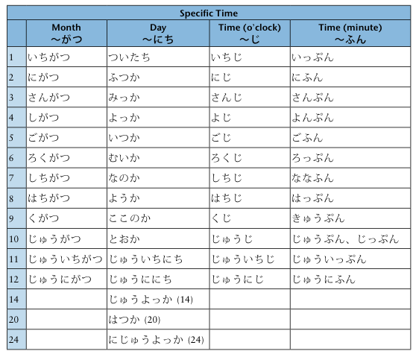
Specific Time (p254 Appendix D)

Slide 8
ぶんぽう

Slide 9
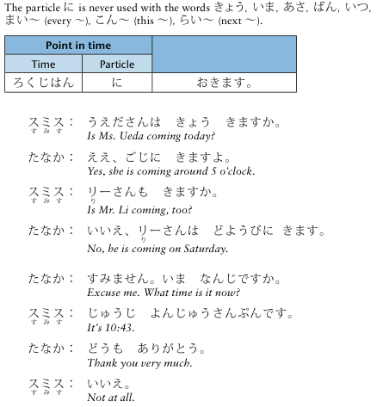
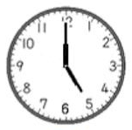
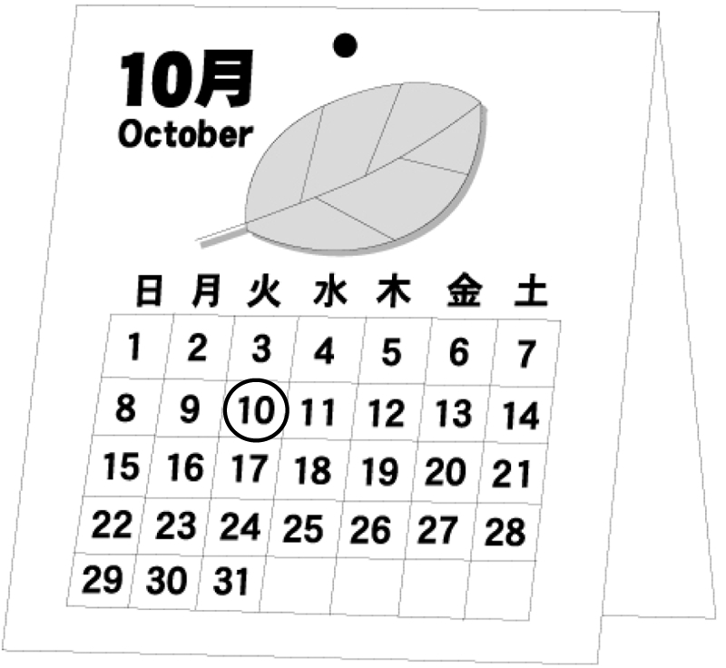
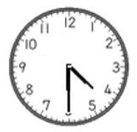
ぶんぽう３： Telling time using the particle に

Slide 10
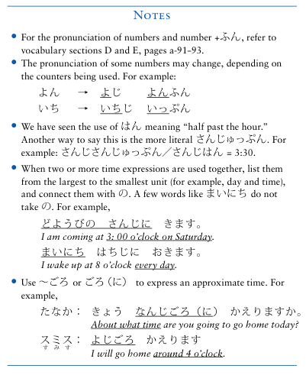
ぶんぽう３： Telling time using the particle に

Slide 11
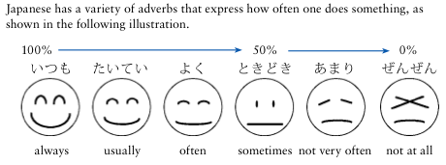
ぶんぽう４： Using adverbs to express frequency of actions

Slide 12
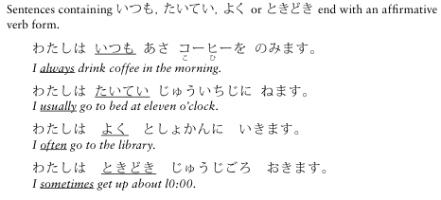
ぶんぽう４： Using adverbs to express frequency of actions

Slide 13
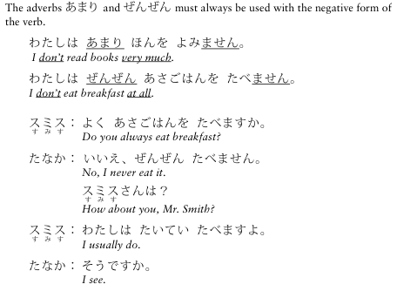
ぶんぽう４： Using adverbs to express frequency of actions

Slide 14
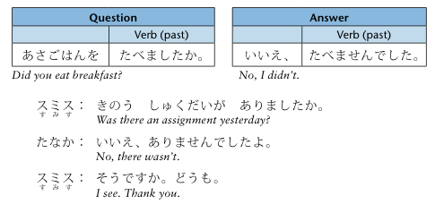
ぶんぽう５： Expressing past action and events using the polite past forms of verbs

Slide 15
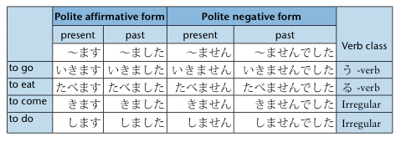
ぶんぽう５： Expressing past action and events using the polite past forms of verbs

Slide 16
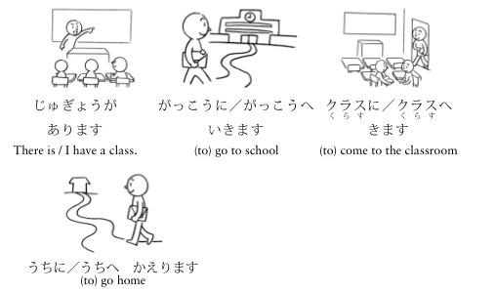
ぶんぽう５： Expressing past action and events using the polite past forms of verbs

