Slide 1
にほんご
JPN101
Oct. 26, 2009
(Monday)

Slide 2
１０月２６日月曜日
ぶんぽう３（adjectives）
ぶんぽう４（～に～があります／います）
ぶんぽう５（よ／ね）
かんじ（Introduction to Kanji, 大、学、校、先、生）

Slide 3
ぶんぽう

Slide 4
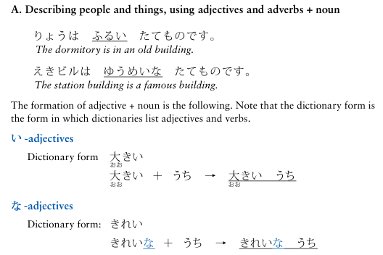
ぶんぽう３： Describing people and things using adjective + noun, and polite present forms of adjectives

Slide 5
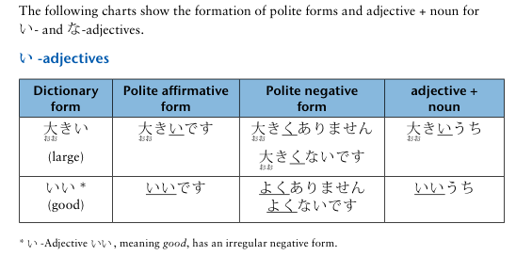
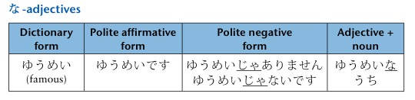
ぶんぽう３： Describing people and things using adjective + noun, and polite present forms of adjectives

Slide 6

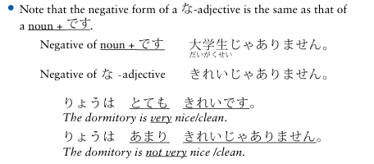
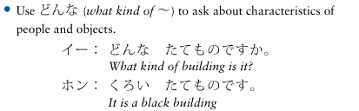
ぶんぽう３： Describing people and things using adjective + noun, and polite present forms of adjectives

Slide 7
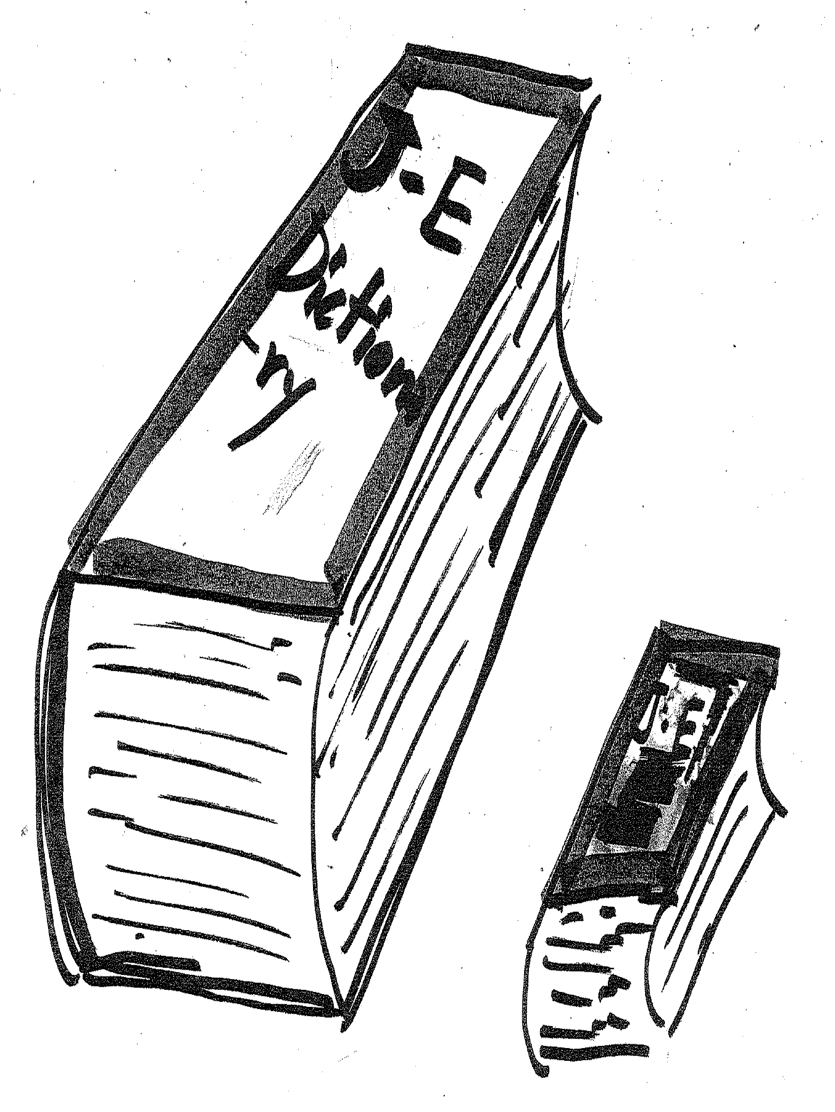
ぶんぽう３： Describing people and things using adjective + noun, and polite present forms of adjectives

Slide 8
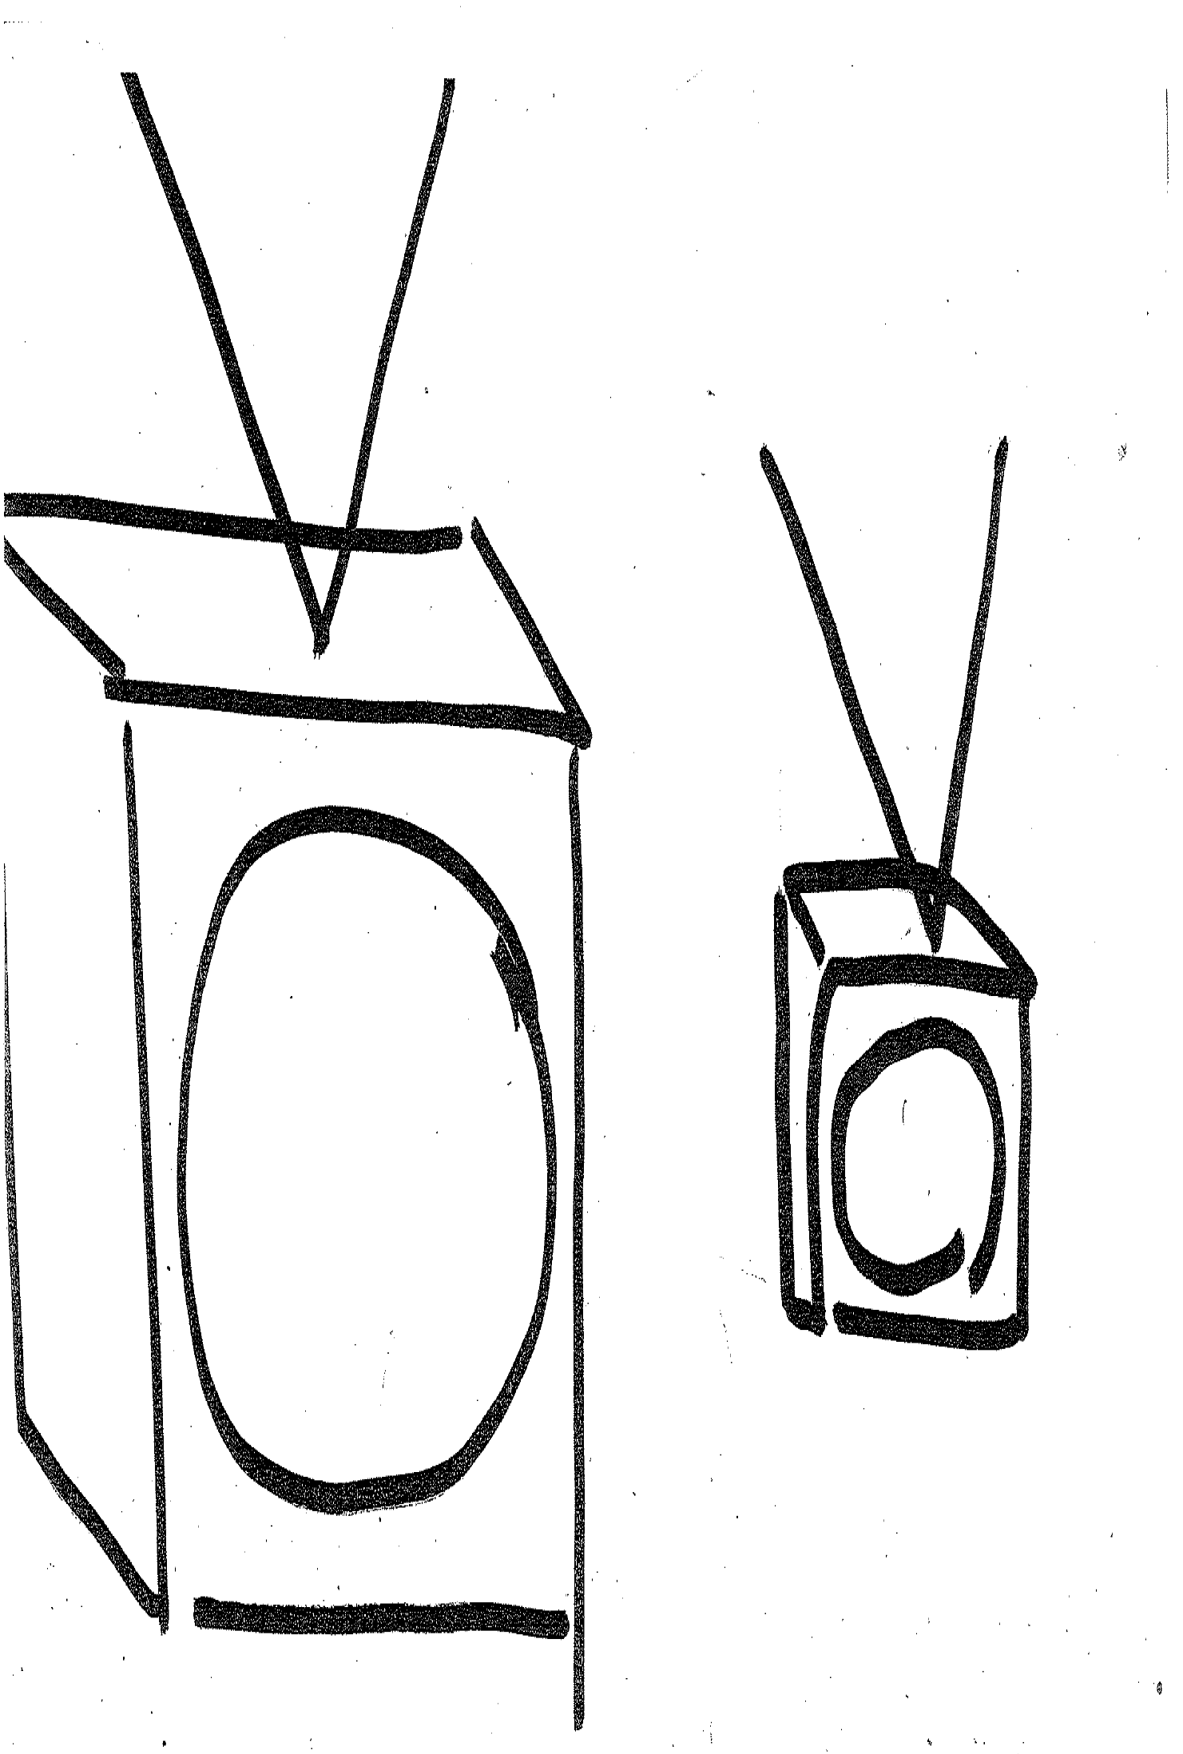
ぶんぽう３： Describing people and things using adjective + noun, and polite present forms of adjectives

Slide 9
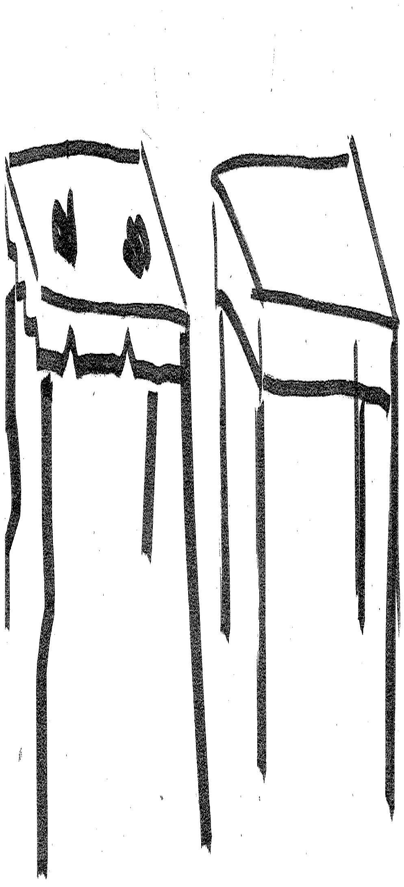
ぶんぽう３： Describing people and things using adjective + noun, and polite present forms of adjectives

Slide 10
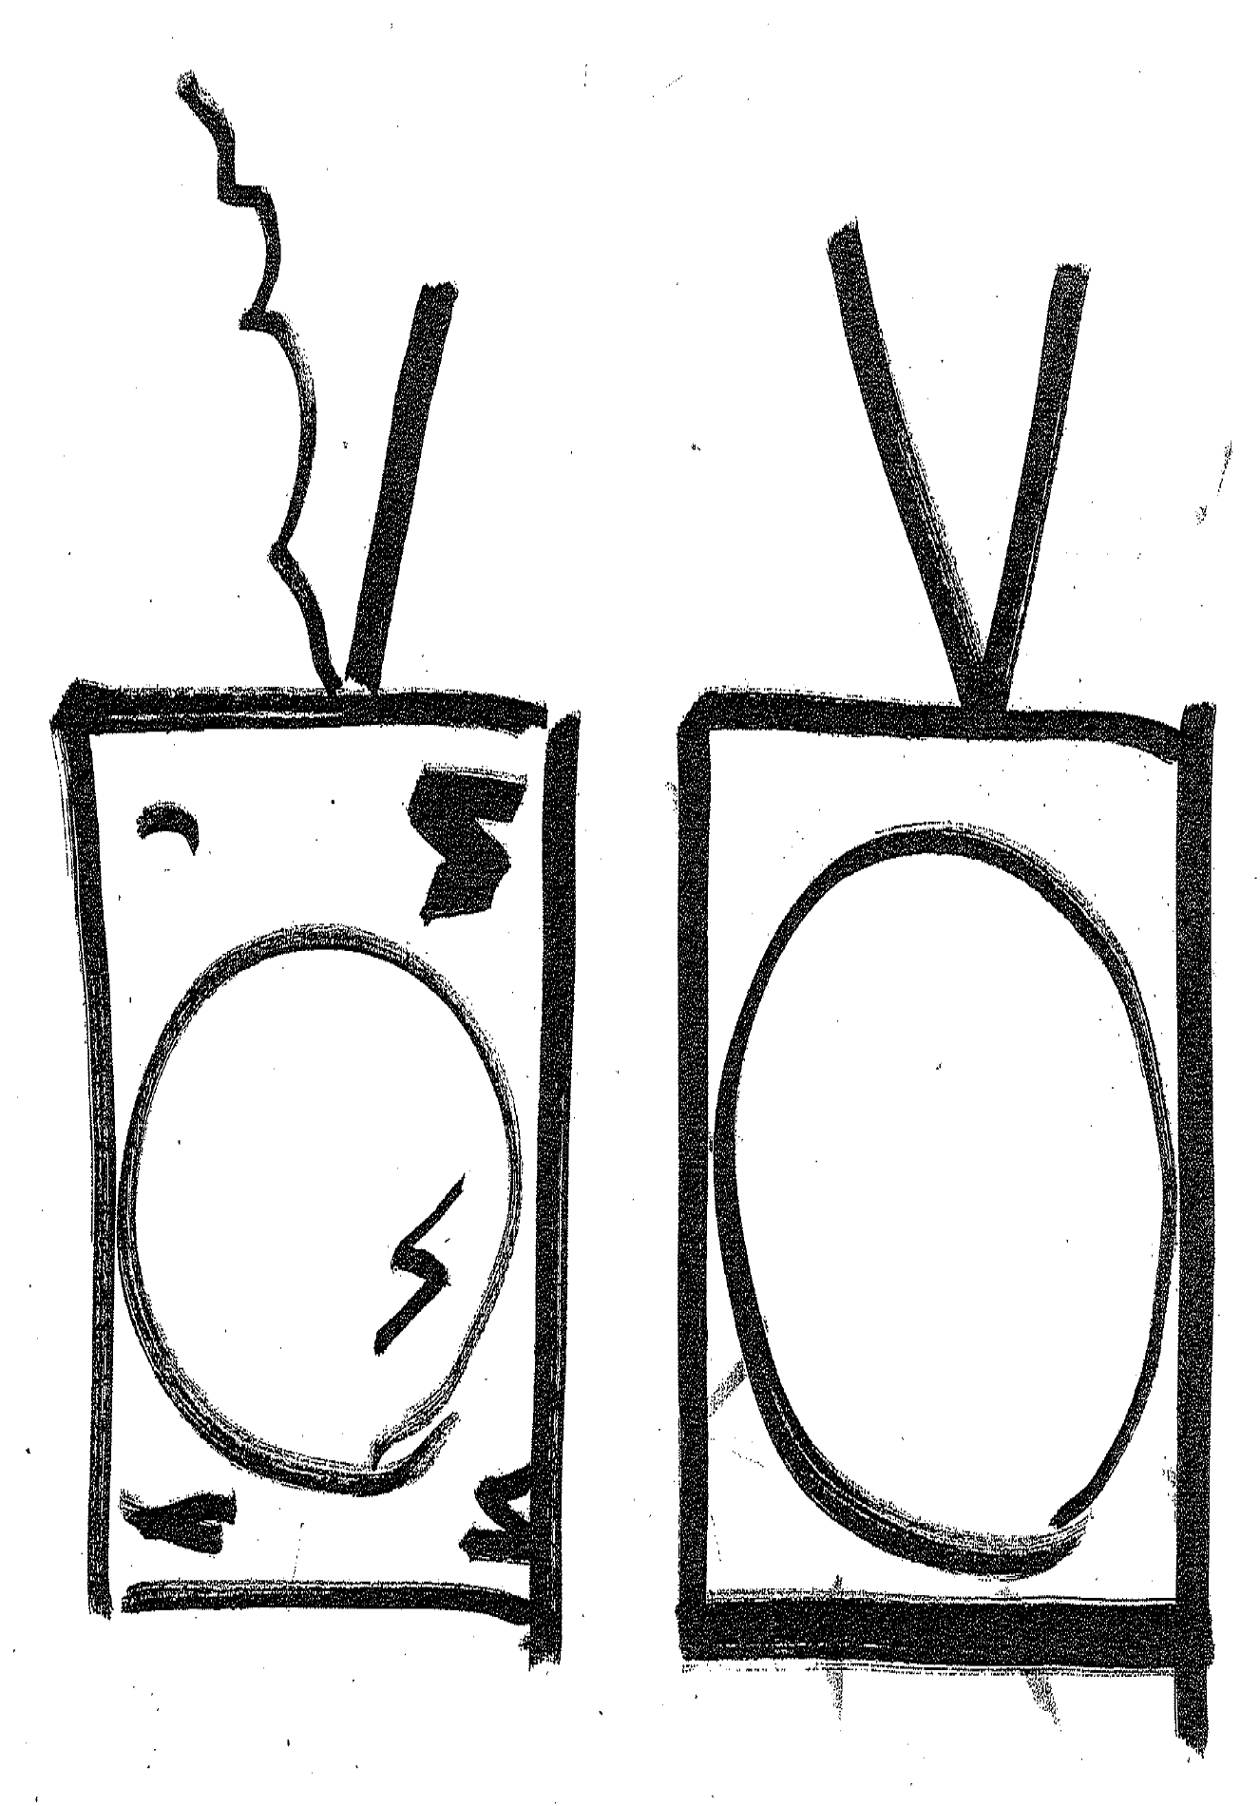
ぶんぽう３： Describing people and things using adjective + noun, and polite present forms of adjectives

Slide 11
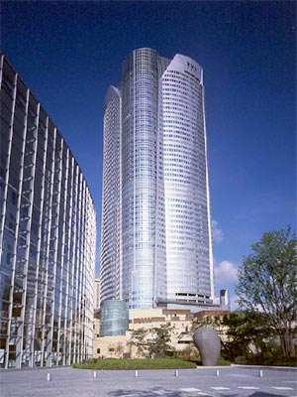
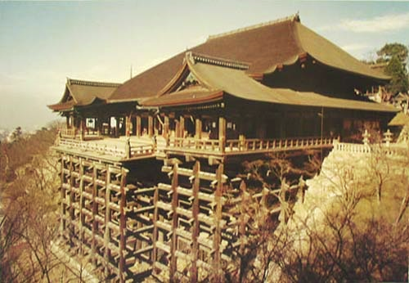
ぶんぽう３： Describing people and things using adjective + noun, and polite present forms of adjectives
ろっぽんぎヒルズ
きよみずでら
Google Image, http://images.google.co.jp/imghp?hl=ja&tab=wi

Slide 12
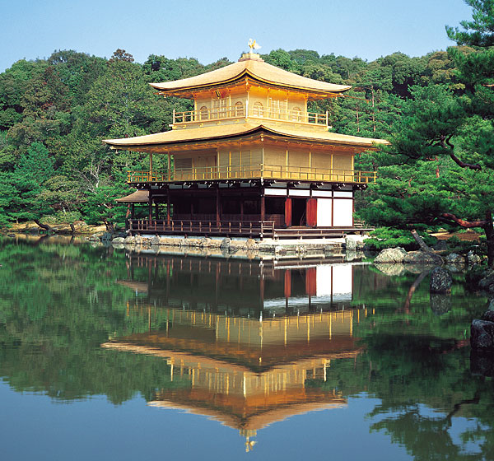
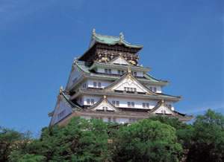
ぶんぽう３： Describing people and things using adjective + noun, and polite present forms of adjectives
きんかくじ
おおさかじょう
(Web Japan, http://web-japan.org/index.html)

Slide 13


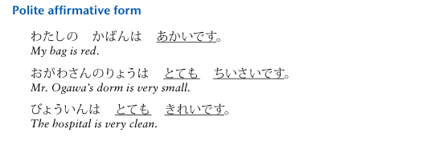
ぶんぽう３： Describing people and things using adjective + noun, and polite present forms of adjectives

Slide 14
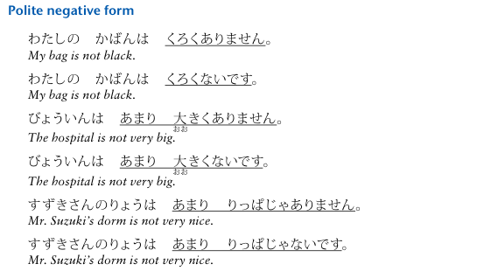
ぶんぽう３： Describing people and things using adjective + noun, and polite present forms of adjectives

Slide 15
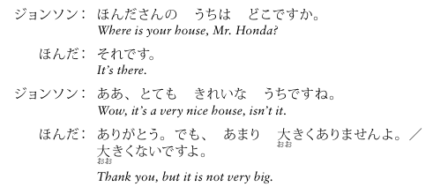
ぶんぽう３： Describing people and things using adjective + noun, and polite present forms of adjectives

Slide 16
ぶんぽう４： Describing people, things, and their locations using
～に～があります／います
Review
1) To describe an object, event, activity, or possession
Noun | Particle | Verb
ほん | が | あります。
There is a book./I have a book.
Noun | Particle | Verb
えいが | が | あります。
There is a movie.
Noun | Particle | Verb
しゅくだい | が | あります。
There is homework./I have homework.

Slide 17
ぶんぽう４： Describing people, things, and their locations using
～に～があります／います
Review
2) To describe where an event will take place
Noun | Particle | Noun | Particle | Verb
としょかん | で | えいが | が | あります。
There is a movie at the library.

Slide 18
ぶんぽう４： Describing people, things, and their locations using
～に～があります／います
Review
To ask for or tell the location of something or someone
S (topic) |  | L |  | V (existence)
Noun | Particle | Question Word | Particle | Verb | Particle
りょう | は | どこ | に | あります | か。
Where is the dormitory?
 |  | L |  | V (existence)
 |  | Noun | Particle | Verb
 |  | あそこ | に | あります。
 |  | It's over there.

Slide 19
ぶんぽう４： Describing people, things, and their locations using
～に～があります／います
New!
4) To describe a scene in which someone or something exists
in a given location or to ask what is in that location.
L |  | S (topic) |  | V (existence)
Noun | Particle | Questioin word | Particle | Verb | Particle
このへん | に | なに | が | あります | か。
What is in this area?
 |  | S (topic) |  | V (existence)
 |  | Noun | Particle | Verb
 |  | こうえん | が | あります。
 |  | There is a park.

Slide 20
ぶんぽう４： Describing people, things, and their locations using
～に～があります／います

Slide 21
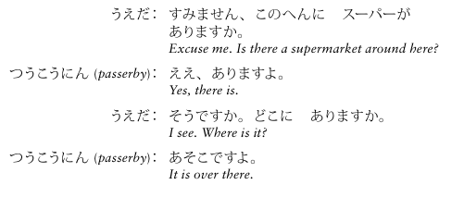
ぶんぽう４： Describing people, things, and their locations using
～に～があります／います

Slide 22
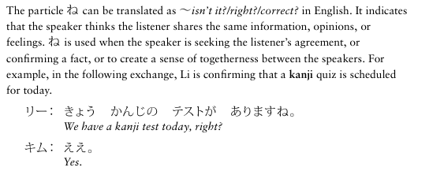
ぶんぽう５： Using よ and ね
Particle ね

Slide 23
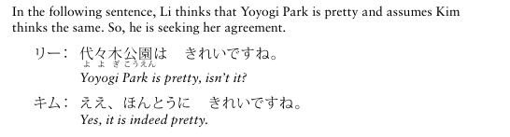
ぶんぽう５： Using よ and ね
Particle ね

Slide 24
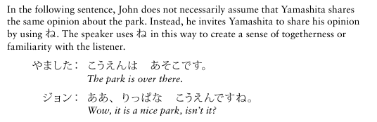
ぶんぽう５： Using よ and ね
Particle ね

Slide 25
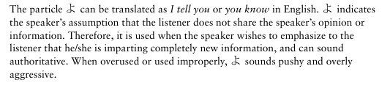
ぶんぽう５： Using よ and ね
Particle よ

Slide 26
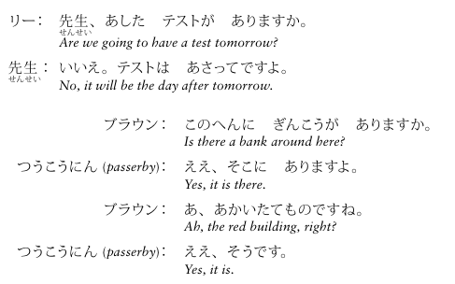
ぶんぽう５： Using よ and ね
Particle よ

Slide 27
かんじ

Slide 28
Why Japanese has three scripts?
- When the kanji arrived to Japan, people didn’t have any script to describe their language (=Japanese).
- They started using kanji like alphabets at first, but since kanji characters are often complicated, they created simplified versions from kanji, which became Katakana and Hiragana (the paths of evolution of katakana and hiragana are different).
- Kanji themselves remain in Japanese, because Kanji can visually provide the meaning, which is very convenient. Also, there were many words that Japanese people didn’t have at that time (especially words that indicate abstract concepts).

Slide 29
Association of Kanji, Picture and meaning
Some of Kanji are actually evolved from a picture, and they are called “pictograph”.
You can use those pictures to memorize the shape and meaning of kanji. Also, you can make your own picture for a kanji.
→
→
→
the sun is round
the new/half moon
the course of water
→
→
person
I am “big”!

Slide 30
Readings of Kanji
When Kanji were adopted, the Chinese way of reading Kanji was also adopted.
At the same time, the characters were given Japanese readings for the existing Japanese words. So, a Kanji has two or more readings.
The Chinese reading of a kanji is called the ON reading (written in katakana in the textbook), and the Japanese reading the KUN reading (written in hiragana).

Slide 31
Example of On and Kun readings
おお (Kun reading)
大きい
ダイ ガク (On reading)
大学
This hiragana part (mostly the
conjugation part of adjective and
verb) is called okuri-gana.

Slide 32
Stroke order
一
川
1
2
3
Rule1: from left to right
川
三
1
Rule2: from top to bottom
3
2
3
2
口
1
Rule3: square
3

Slide 33

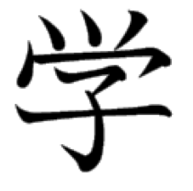
Three types of strokes
stop
stop
release
hook

Slide 34
きょうのかんじ
大、学、校、先、生

Slide 35

おお（きい）
ダイ
大学生

Slide 36

まな（ぶ）
ガク、ガッ
学校、大学

Slide 37

コウ
学校

Slide 38

さき
セン
先生

Slide 39

なま、う（まれる）
セイ
学生、先生

