Slide 1
にほんご JPN101
Oct. 28, 2009
(Wednesday)

Slide 2
１０月２８日水曜日
にほんのぶんか
ききじょうずはなしじょうず
ダイアローグ
よむれんしゅう
きくれんしゅう

Slide 3
にほんのぶんか

Slide 4
P134-135 にほんのぶんか
Geography and demographics of Japan
http://www.us-tradeshow.com/info_us.htm

Slide 5
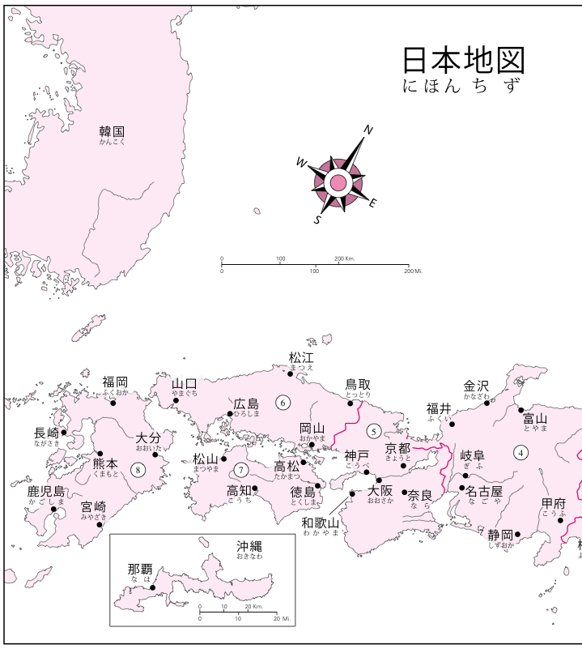
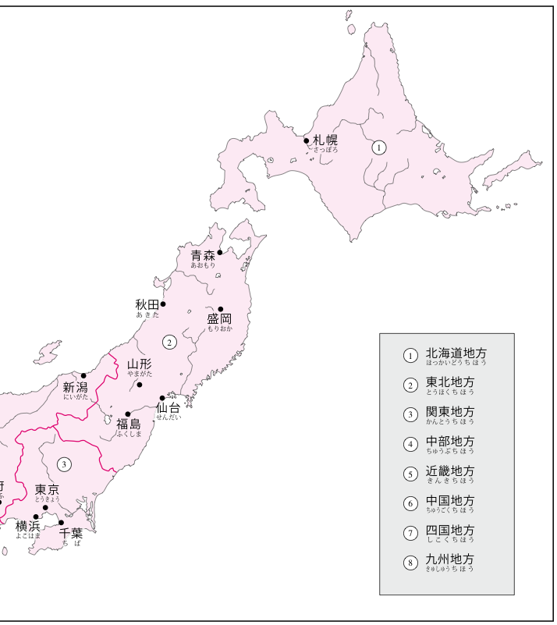
P134-135 にほんのぶんか
Geography and demographics of Japan

Slide 6
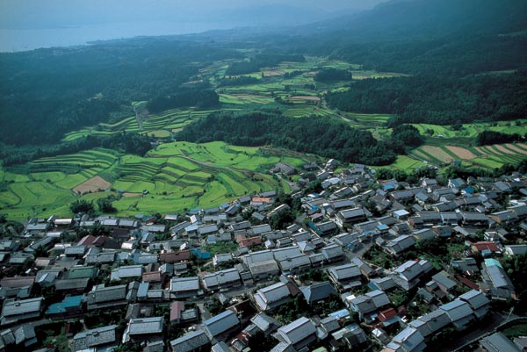
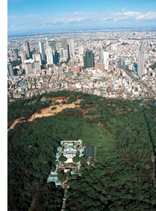
P134-135 にほんのぶんか
Geography and demographics of Japan
Ogi is a rural district located in the city of Otsu, Shiga Prefecture, in central Japan. This is one typical view of Japan — thick forests, a village, and terraced rice fields. Forests still play an important role in life in Japan, and conservation is practiced.
An aerial view of the woodland around Meiji Shrine. In Shinjuku, about 2 km north of center of this dense forest, there is another "forest" of tall buildings.
(Web Japan, http://web-japan.org/index.html)

Slide 7
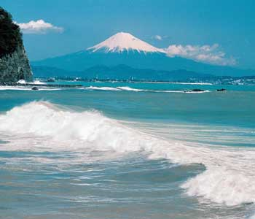
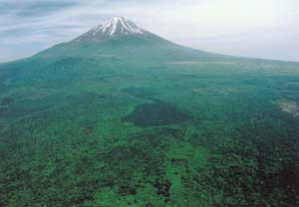
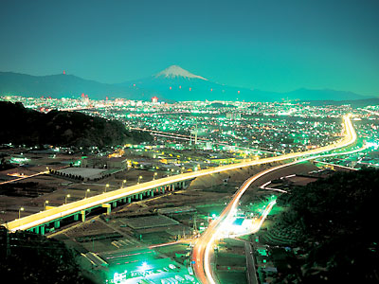
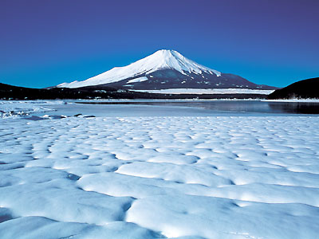
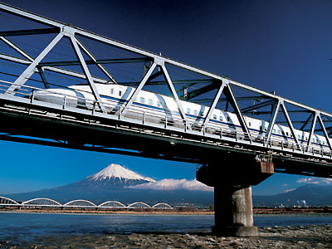
P134-135 にほんのぶんか
Geography and demographics of Japan
(Web Japan, http://web-japan.org/index.html)

Slide 8
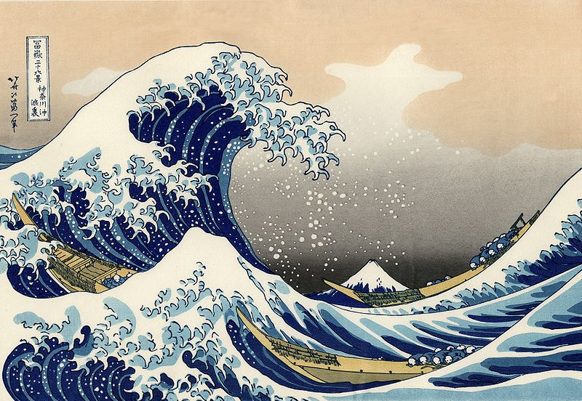
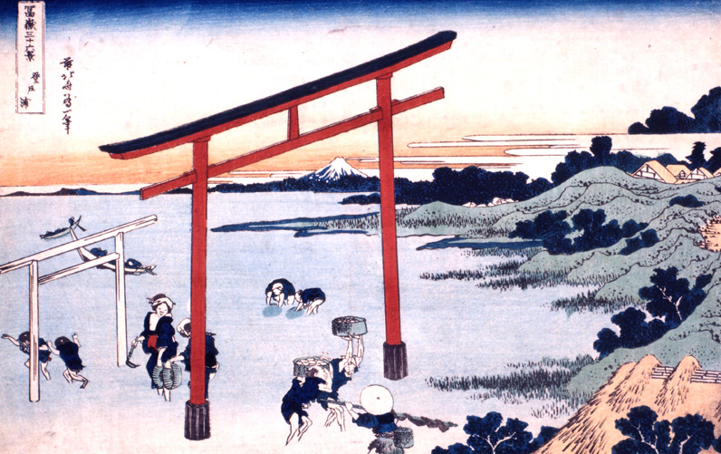
P134-135 にほんのぶんか
浮世絵（うきよえ）
葛飾北斎（かつしかほくさい）
冨獄三十六景（ふがくさんじゅうろっけい）
http://www.tomoiki.tv/fugaku36/main.html

Slide 9
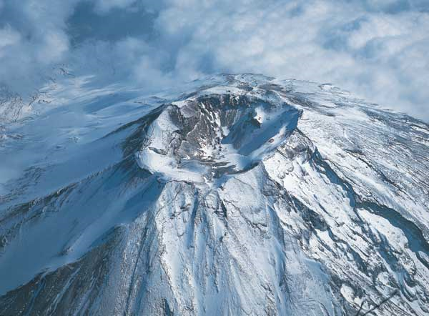
P134-135 にほんのぶんか
Geography and demographics of Japan
The summit seen from the air. Crater diameter, about 800 meters; depth, about 200 meters.
(Web Japan, http://web-japan.org/index.html)

Slide 10
P134-135 にほんのぶんか
Geography and demographics of Japan
Left: Ikeda-kan, a mountain hostel at the eighth station. Everyone going up is tired by this time. Rest breaks tend to get longer, the higher you go.
Center: The sign says “90 minutes to the top,” but it is a tough 90 minutes and maybe more.
Right: This vending machine stands at 3,590 meters above sea level, making it the highest one in Japan. Prices? They are also the highest—about triple what they are below.
(Web Japan, http://web-japan.org/index.html)

Slide 11
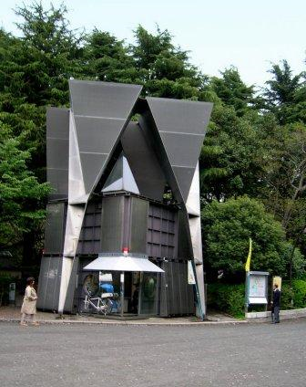
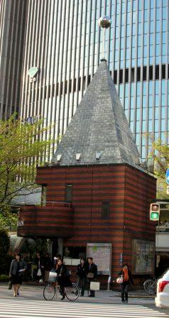
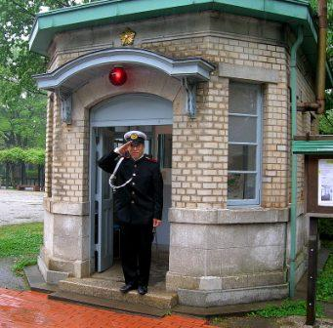
P134-135 にほんのぶんか
Japanese neighborhoods
Koban in Ueno Park
The Brick koban is
in Ginza
Koban at the Edo-Tokyo open air Architectural Museum
(Yokoso!Japan, http://www.japantravelinfo.com/top/index.php)

Slide 12
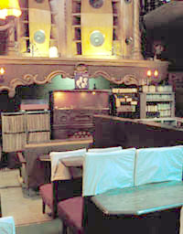
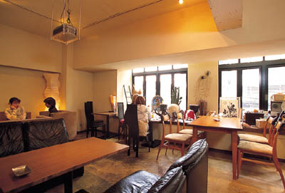
P134-135 にほんのぶんか
きっさてん
The Meikyoku Kissa Lion was established in 1926. Thick curtains cover the windows to improve the acoustics. People come for the relaxing surroundings, and to listen to music, read or study.
The owner of the Shichimencho Café brought some of the furniture here from her own house, and had some custom-made. The menu offers plenty of variety, from organic coffee and Chinese tea to meals and alcohol.
(Web Japan, http://web-japan.org/index.html)

Slide 13
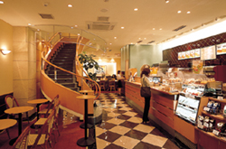
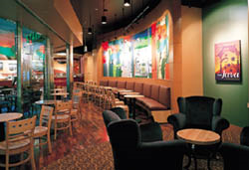
P134-135 にほんのぶんか
カフェ
At Doutor Coffee outlets, you give your order at a counter, then carry it to your seat. The national chain serves an average of 540,000 people every day.
Inside a Starbucks outlet. The coffee comes from high-quality beans and has an excellent flavor. An oasis away from home and the office.
(Web Japan, http://web-japan.org/index.html)

Slide 14
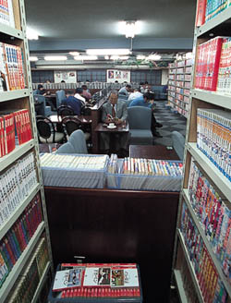
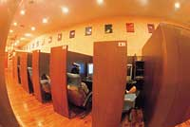
P134-135 にほんのぶんか
まんがきっさ／カフェ
Cubicles in a manga cafe
Despite the name, manga cafes are typically equipped not only with manga (comic books) but also with computers and video games. But on top of this regular fare, tanning rooms, foot baths, and even massages have joined the menus of the more deluxe establishments. As their services expand, manga cafes are taking on a new name, complex cafes. While maintaining the quiet for which they have been known, these cafes are evolving into hideouts where customers can concentrate on work or simply chill out in the privacy of their cubicles.
About 200 people come to Tokyo Manga Tantei-dan every day. The shelves are packed with manga, all waiting for customers to choose and relax with.
(Web Japan, http://web-japan.org/index.html)

Slide 15
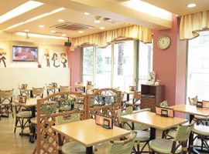
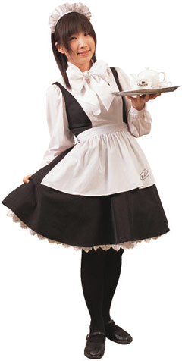
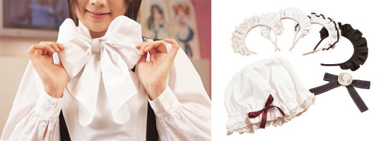
P134-135 にほんのぶんか
メイドきっさ／カフェ
Inside a maid café. The illustrations on the wall make it obvious this is no ordinary café.
Left: The maid's uniform, with white apron dress and flouncy ribbon, is unforgettable. Right: The maids can choose from a number of hat styles, hair accessories and small pieces of flair.
Alisa has been working at the same maid café since it opened more than four years ago.
(Web Japan, http://web-japan.org/index.html)

Slide 16
ききじょうずはなしじょうず

Slide 17
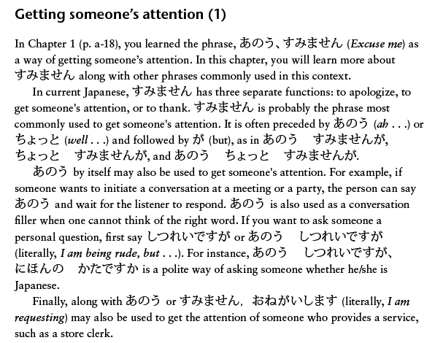
P159 ききじょうずはなしじょうず

Slide 18
P159 ききじょうず

Slide 19
ダイアローグ

Slide 20
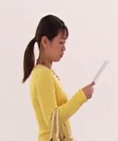
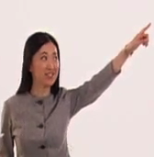
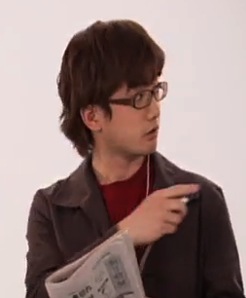
P132 ダイアローグ
「このへんに ぎんこうが ありますか。」
渋谷駅
（しぶやえき）
エレベーター
なかま銀行
（なかまぎんこう）

Slide 21
P132 ダイアローグ
きいてください。

Slide 22
P132 ダイアローグ

Slide 23
P132 ダイアローグ （じまく）

Slide 24
よむれんしゅう

Slide 25
P162 よむれんしゅう

Slide 26
P163 よむれんしゅう
￥

Slide 27
きくれんしゅう

Slide 28
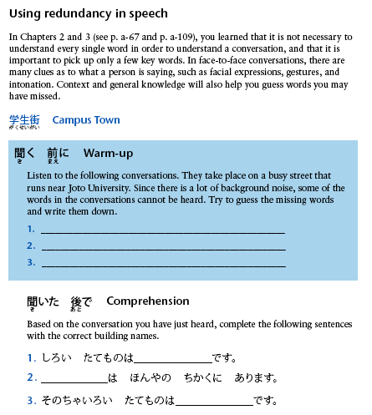
P158 きくれんしゅう

