Slide 1
にほんご
JPN101
Nov. 16, 2009
(Monday)

Slide 2
１１月１６日月曜日
日本のぶんか
ききじょうずはなしじょうず
ダイアローグ
よむれんしゅう
きくれんしゅう

Slide 3
日本のぶんか

Slide 4
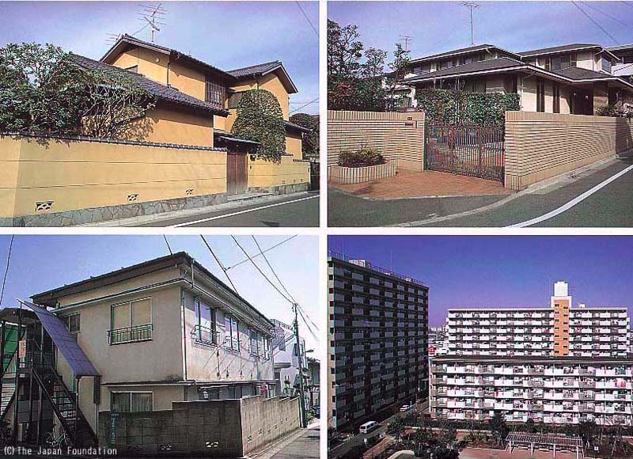
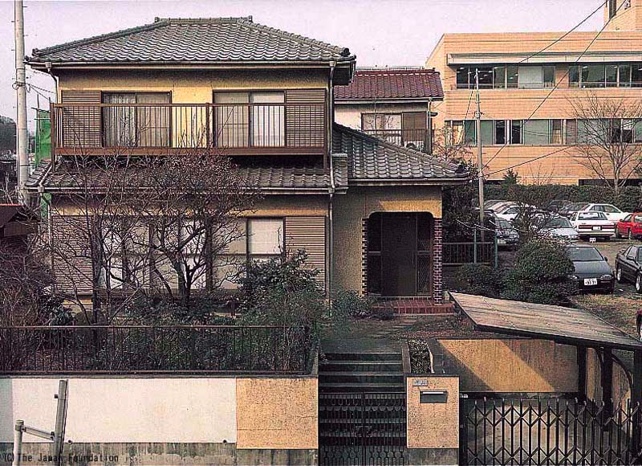
P176-177 日本のぶんか
日本の うち
(minnanokyozai, http://minnanokyozai.jp/kyozai/home/ja/render.do)

Slide 5
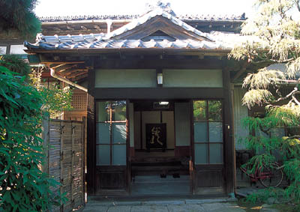
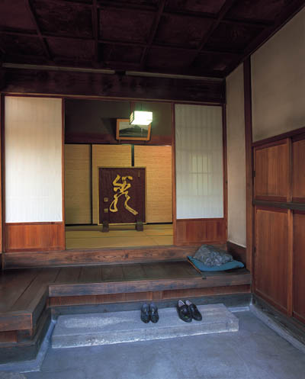
P176-177 日本のぶんか
げんかん
The genkan (vestibule) of a house built about 80 years ago. Old-fashioned genkan like this one are now very rare.
Visitors would stand on the concrete floor (tataki, (1) ) and wait for someone living in the house to answer their call. They are then greeted from the inner vestibule (yoritsuki, (4) ), and invited to enter. They take off their shoes and leave them on the stone step (2). Next, they step up to the wooden step (shikidai, (3) ), then to the yoritsuki. The yoritsuki often has a decorative screen.
(Web Japan, http://web-japan.org/index.html)

Slide 6
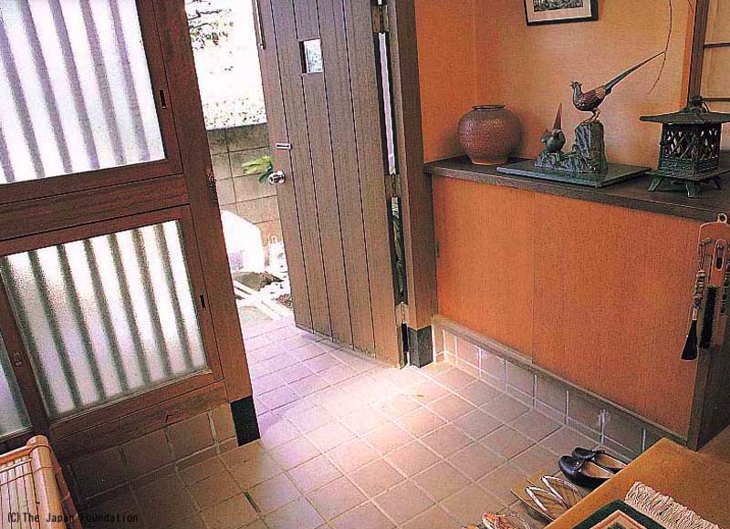
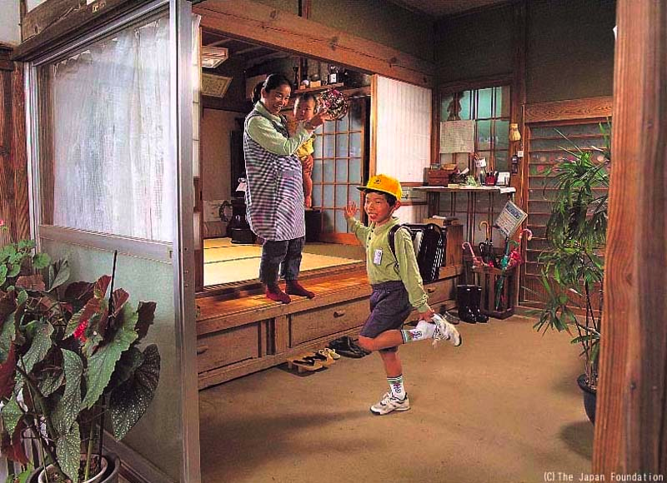
P176-177 日本のぶんか
げんかん
(minnanokyozai, http://minnanokyozai.jp/kyozai/home/ja/render.do)

Slide 7
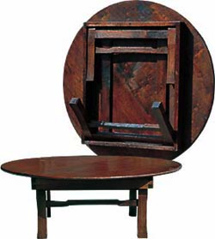
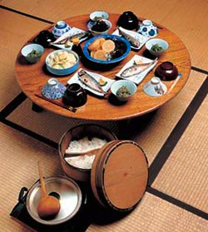
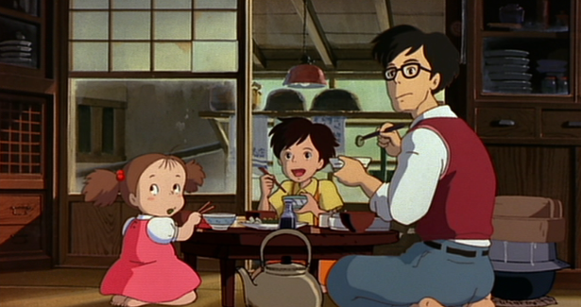
P176-177 日本のぶんか
Tidy storage, the Japanese way fold up small, open up big
Chabu-dai tables have folding legs (photo on top shows one set of legs folded in). Standard height, around 31 cm.
A chabu-dai table set for four. A common sight in homes in the 1960s. The rice tub in the foreground holds enough rice for all family members.
(Web Japan, http://web-japan.org/index.html)
(movie, tonari no totoro)

Slide 8
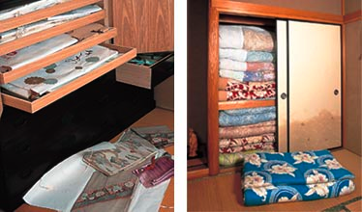
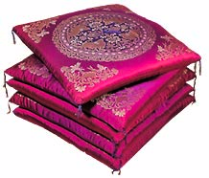
P176-177 日本のぶんか
Tidy storage, the Japanese way fold up small, open up big
Above left: Each folded kimono is placed in its own thick Japanese-paper wrapping, and then placed in a specially made chest. Because of their straight tailored lines, kimono can be folded into a flat, rectangular shape, free of wrinkles and taking up little space.
Above center: Futon and other bedding are folded and placed in an oshiire closet. In a Japanese-style room, the closet is an important place for storage.
Above right: These cotton-stuffed zabuton cushions are placed on the tatami mat floor — one for each person. Long ago, straw was woven into a round cushion called enza. Today's zabuton evolved from them.
(Web Japan, http://web-japan.org/index.html)

Slide 9
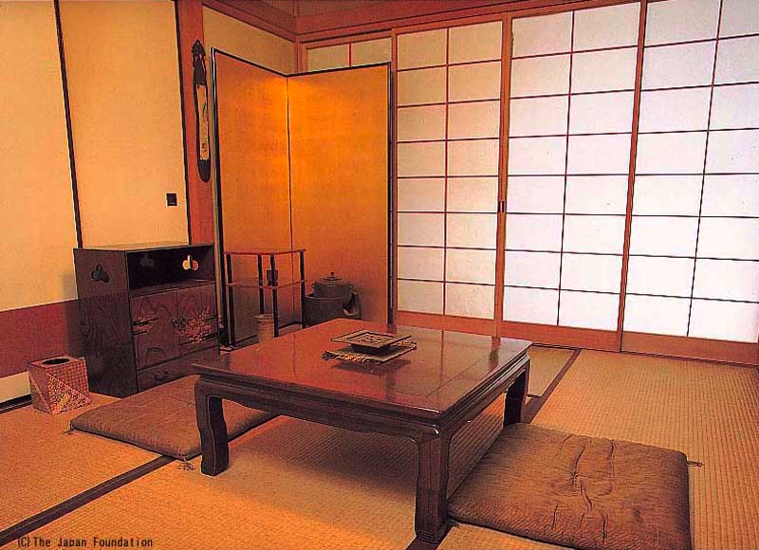
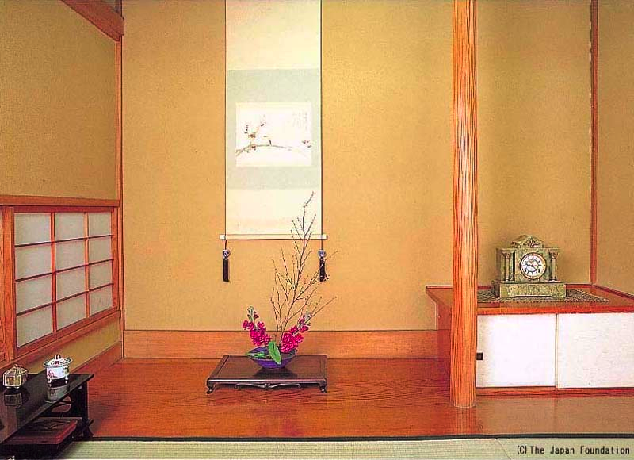
P176-177 日本のぶんか
和室（わしつ） Traditional Japanese room
しょうじ
ふすま
たたみ
ざぶとん
とこのま
(minnanokyozai, http://minnanokyozai.jp/kyozai/home/ja/render.do)

Slide 10
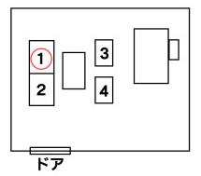
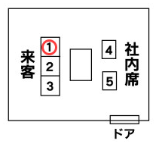
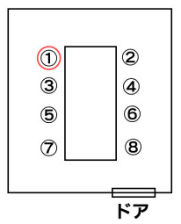
P176-177 日本のぶんか
上座（かみざ）・下座（しもざ）
This is directly translated to Upper seat and lower seat.
These are positions or seating orders for business persons that are applied in rooms and public transportation.
Here are some examples. Numbers go from most important person to least important person.
(BUKISA, http://www.bukisa.com)
(ビジネスマナーガイド, http://ビジネスマナー.biz/450seki/)

Slide 11
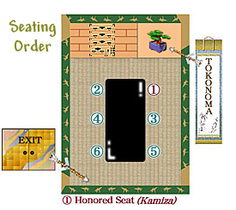
P176-177 日本のぶんか
上座（かみざ）・下座（しもざ）
とこのま
(She Japan, http://www.shejapan.com/)

Slide 12
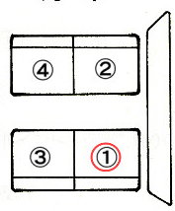
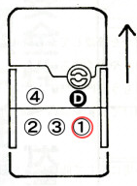
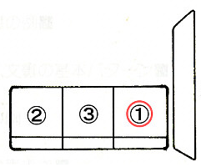
P176-177 日本のぶんか
上座（かみざ）・下座（しもざ）
まど
まど
タクシー
でんしゃ
ひこうき
(BUKISA, http://www.bukisa.com)
(ビジネスマナーガイド, http://ビジネスマナー.biz/450seki/)

Slide 13
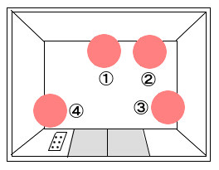
P176-177 日本のぶんか
上座（かみざ）・下座（しもざ）
エレベーター
(BUKISA, http://www.bukisa.com)
(ビジネスマナーガイド, http://ビジネスマナー.biz/450seki/)

Slide 14
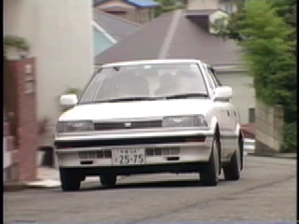
P176-177 日本のぶんか

Slide 15
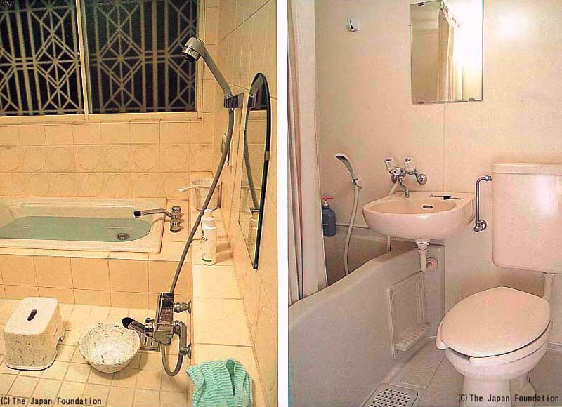
P176-177 日本のぶんか
おふろ
(Web Japan, http://web-japan.org/index.html)
(minnanokyozai, http://minnanokyozai.jp/kyozai/home/ja/render.do)

Slide 16
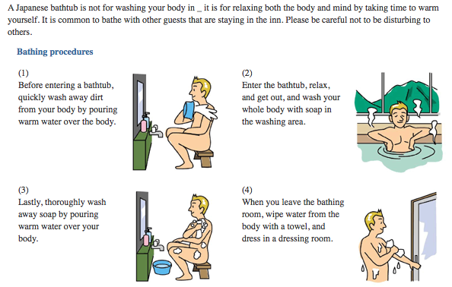
P176-177 日本のぶんか
おふろ
(Welcome to Chiba, http://www.chiba-tour.jp)

Slide 17
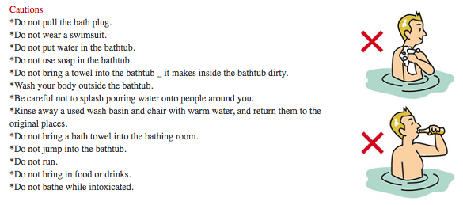
P176-177 日本のぶんか
おふろ
(Welcome to Chiba, http://www.chiba-tour.jp)

Slide 18
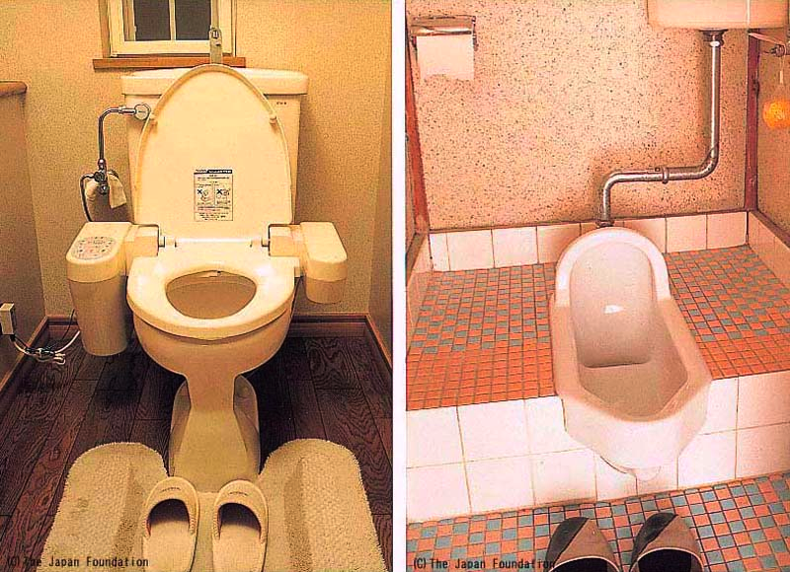
P176-177 日本のぶんか
トイレ
(minnanokyozai, http://minnanokyozai.jp/kyozai/home/ja/render.do)

Slide 19
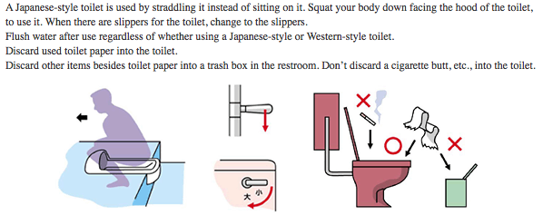
P176-177 日本のぶんか
トイレ
(Welcome to Chiba, http://www.chiba-tour.jp)

Slide 20
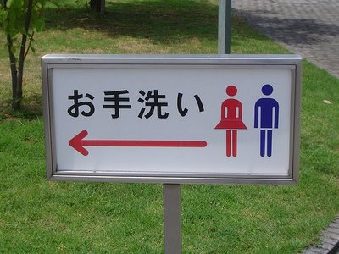
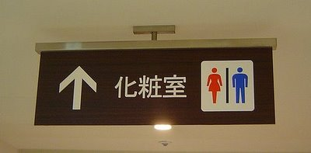
P176-177 日本のぶんか
トイレ
(It’s a (Japanese) sign, http://itsajapanesesign.blogspot.com/

Slide 21
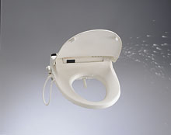
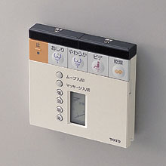
P176-177 日本のぶんか
ウォシュレット
Many Toto employees assisted in the development of the Washlet by serving as the subjects of various tests. They actually sat on the toilet seat to help discover the ideal conditions for cleansing, including the nozzle length and position, spraying angle, and water temperature. In order to prevent scalding from hot water, tests were also held to find out what the highest bearable temperature was. Employees both young and old took part, and some unlucky people could be heard screaming in pain at the heat of the water. After much experimenting, the developers settled on 38 degrees Celsius (100 degrees Fahrenheit), slightly above human body temperature, as the most comfortable water temperature.
Great improvements have been made since that time, and Washlets today have many amazing features. Heated seats have become standard, and the newest models can oscillate the water pressure, automatically absorb the smell after a user leaves the seat, and even warm up the entire lavatory at a preset time.
The Washlet has a nozzle that emits warm water. (Toto)
The control pad for a Washlet. (Toto)
(Web Japan, http://web-japan.org/index.html)

Slide 22
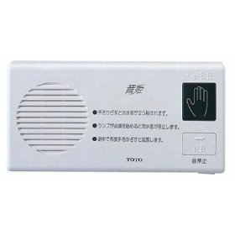
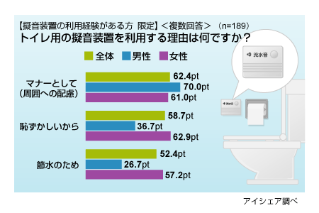
P176-177 日本のぶんか
音姫（おとひめ）
Sound comes out from this radio-like box. (Toto)
(Web Japan, http://web-japan.org/index.html)
(Ishare, http://release.center.jp/)

Slide 23
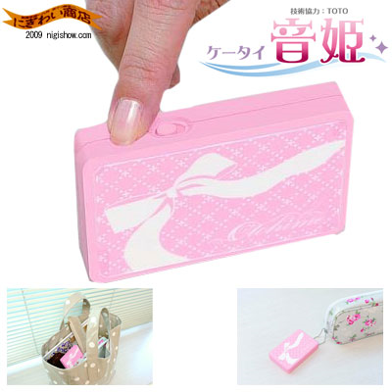
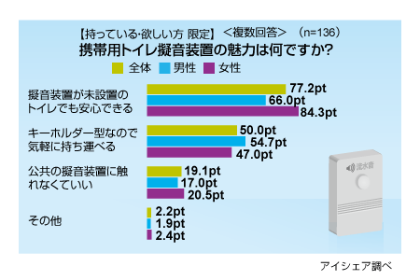
P176-177 日本のぶんか
ケータイ音姫（おとひめ）
(rakuten, http://item.rakuten.co.jp/)
(Ishare, http://release.center.jp/)

Slide 24
ききじょうずはなしじょうず

Slide 25
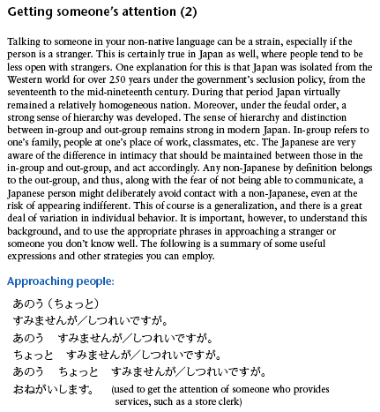
P201 ききじょうずはなしじょうず

Slide 26
ダイアローグ

Slide 27
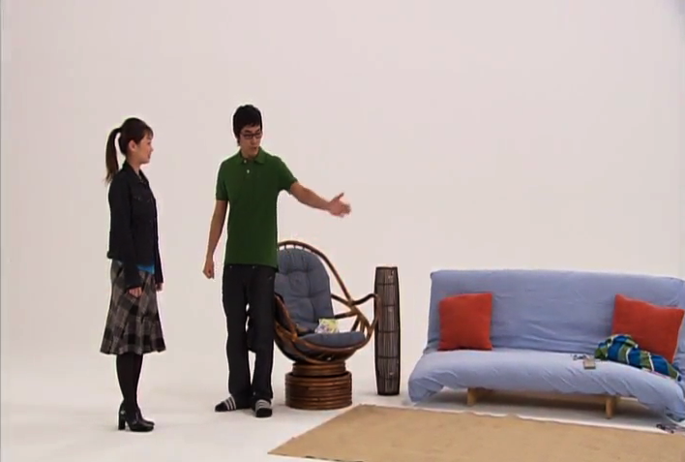
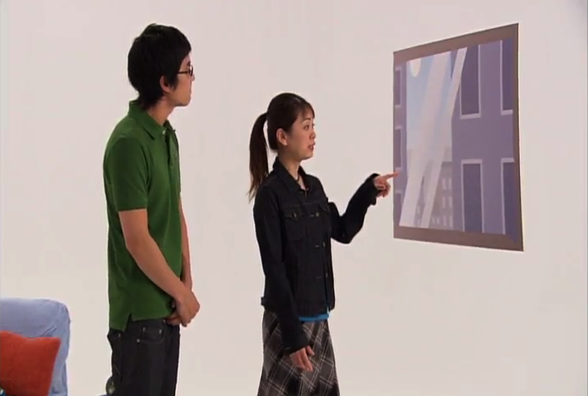
P173 ダイアローグ
「リーさんのアパート」
ごめん下さい。
いらっしゃい。
あがって下さい。
おじゃまします。
このアパートは たかいところに
ありますから。
へえ、はやいですね。

Slide 28

P173 ダイアローグ
きいてください。

Slide 29
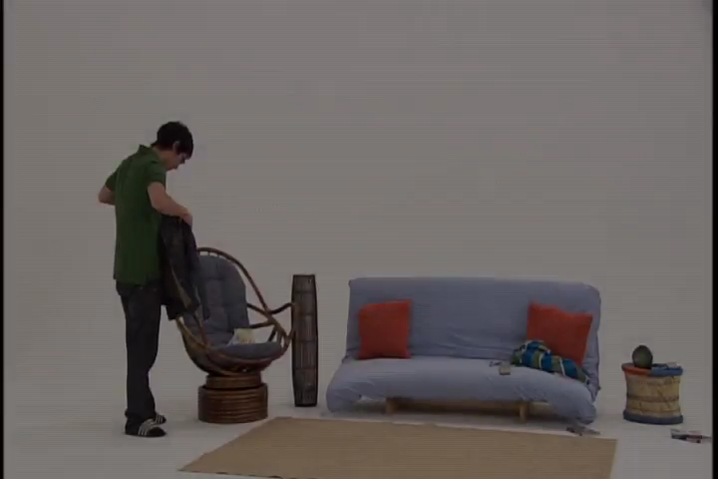
P173 ダイアローグ

Slide 30
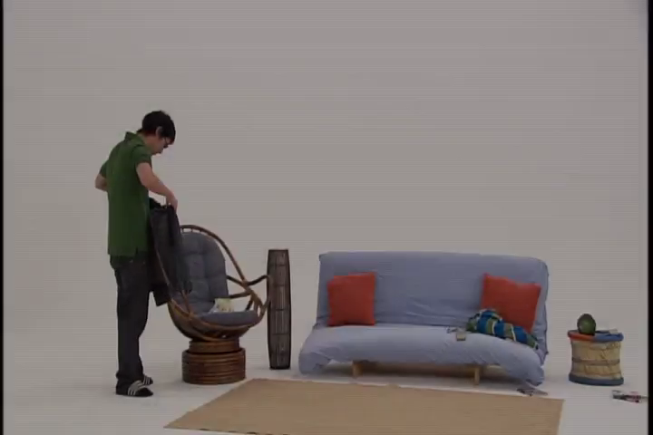
P173 ダイアローグ （じまく）

Slide 31
よむれんしゅう

Slide 32
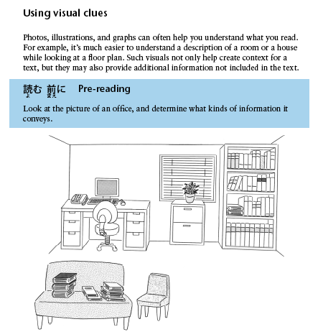
P206 よむれんしゅう

Slide 33
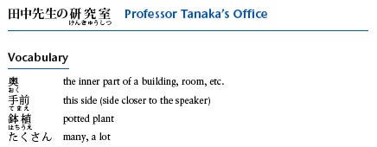
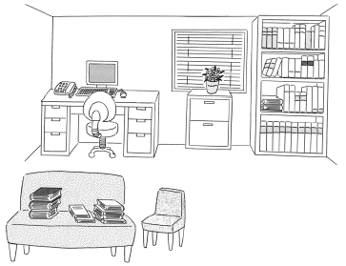
P206 よむれんしゅう

Slide 34
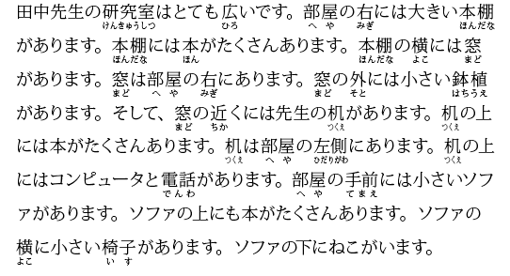
P206 よむれんしゅう

Slide 35
きくれんしゅう

Slide 36
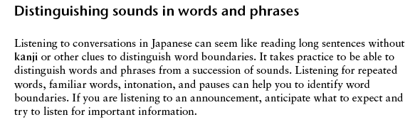
P199 きくれんしゅう

Slide 37
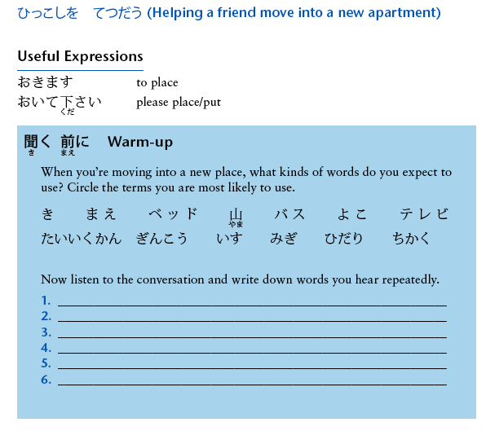
P199 きくれんしゅう

Slide 38
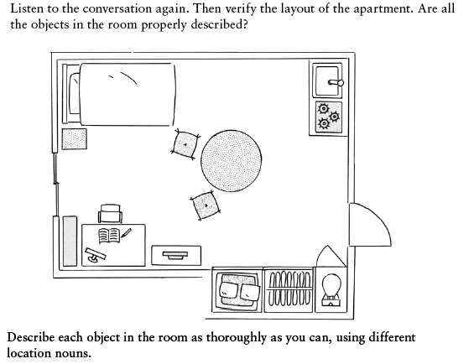
P199 きくれんしゅう

