Slide 1
にほんご JPN101
Dec. 9, 2009
(Wednesday)

Slide 2
１２月９日水曜日
日本のぶんか
ききじょうずはなしじょうず
ダイアローグ
よむれんしゅう
きくれんしゅう

Slide 3
日本のぶんか

Slide 4
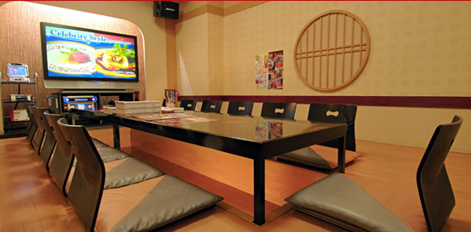
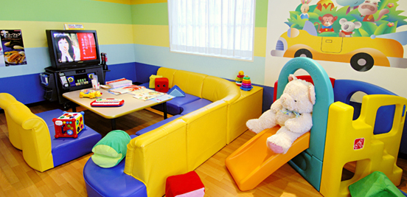
カラオケのへや
わしつ
キッズルーム
ワンだふるルーム
バリアフリー

Slide 5
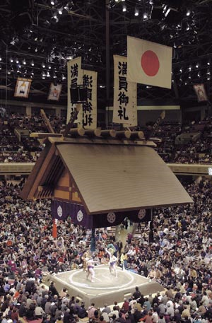
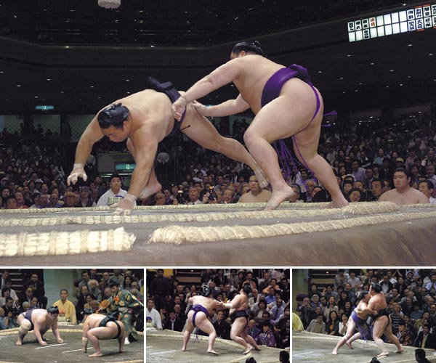
相撲（すもう）
Inside the Kokugikan stadium, every seat is taken. The roof suspended over the ring weighs 6 tons. Four massive tassels, each a different color (white, black, scarlet and green), represent pillars supporting the roof at its corners.
Web Japan, http://web-japan.org/

Slide 6
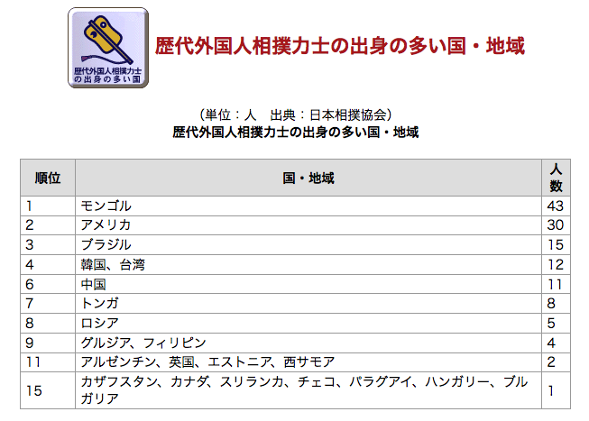
相撲（すもう）
（Ministry of Foreign Affairs of Japan, http://www.mofa.go.jp)

Slide 7
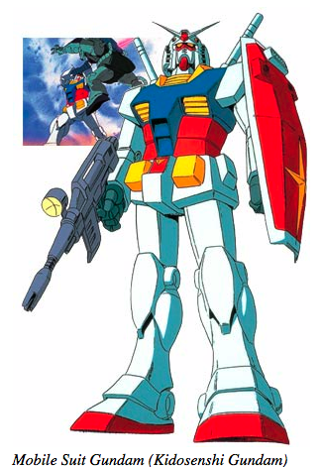
アニメ
てつわんアトム (Astro Boy) is a Monga series first in 1952 and television program first broadcast in 1963.
となりのトトロ (My Neighbor Totoro) is a 1988 Anime film.
Originally broadcast from 1979 to 1980.

Slide 8
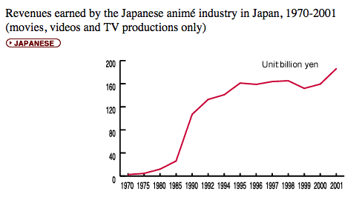
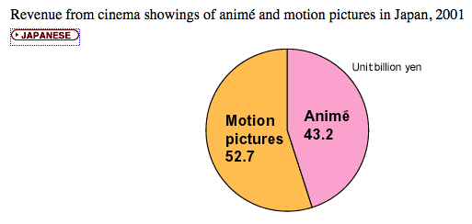
アニメ
Web Japan, http://web-japan.org/

Slide 9
おたく
Otaku is the Japanese word for people with a consuming interest in pop culture, especially animated films (animé), comics (manga) and video games. The word is becoming part of an international vocabulary, like that other Japanese word, “karaoke.”
Web Japan, http://web-japan.org/

Slide 10
コスプレ
Left: In 1992, Bishoujo Senshi Sailor Moon became a hit after appearing simultaneously in a magazine series and an animé. Right: A two-woman team enjoying cosplay ("costume play," or dressing up as pop media characters) in Tokyo's Akihabara district. (Photo: Nose Hirofumi)

Slide 11
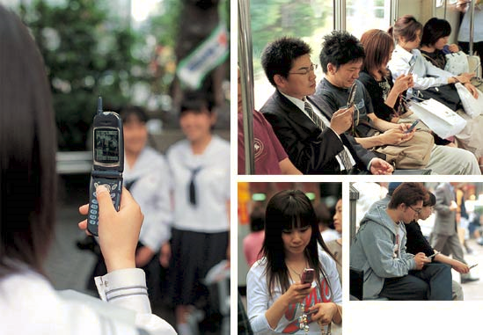
携帯電話（けいたいでんわ）
People on city streets and trains, gazing intently at their cell phone screens. The phones offer mobile connections to the Internet and e-mail services. Many people also use their cell phone as a camera, to capture digital snapshots of those special moments (see left photo).

Slide 12
ききじょうずはなしじょうず

Slide 13
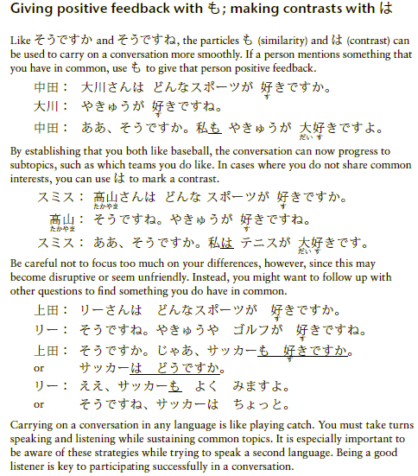
P38 ききじょうずはなしじょうず

Slide 14
ダイアローグ

Slide 15
P11 ダイアローグ
「上田さんと リーさんの しゅみ」

Slide 16
P11 ダイアローグ
きいてください。

Slide 17
P11 ダイアローグ

Slide 18
P11 ダイアローグ （じまく）

Slide 19
よむれんしゅう

Slide 20
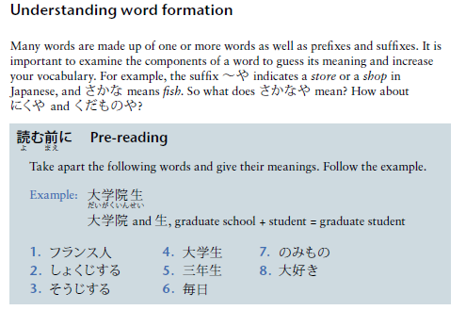
P43 よむれんしゅう

Slide 21
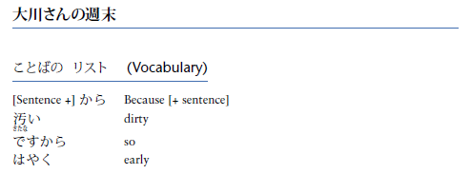
P43 よむれんしゅう

Slide 22
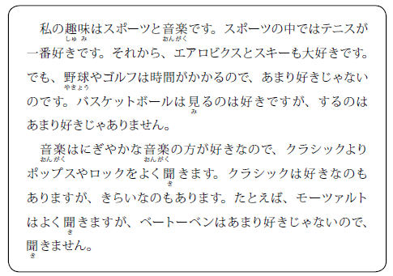
P44 よむれんしゅう

Slide 23
P44 よむれんしゅう

Slide 24
P44 よむれんしゅう

Slide 25
P44 よむれんしゅう

Slide 26
きくれんしゅう

Slide 27
P38 きくれんしゅう

Slide 28
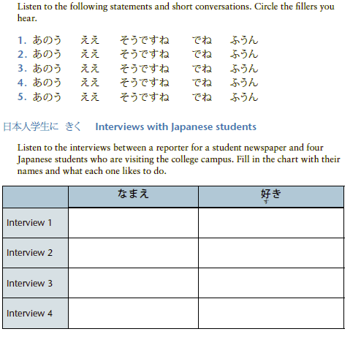
P38 きくれんしゅう

