Slide 1
日本語 JPN102
Mar. 3, 2010
(Wednesday)

Slide 2
３月３日水曜日
ダイアローグ
読むれんしゅう
聞くれんしゅう

Slide 3
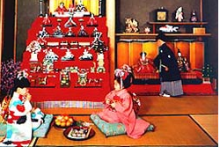
ひなまつり (Doll Festival)
March 3 in Japan is the day of the Doll Festival, also known as Girls’ Day, when families display sets of traditional Japanese dolls in their house. The Doll Festival is an occasion for a family to pray for the health and happiness of girls.
Most families take their beautiful collection of dolls out of the closet around mid-February and put it away again as soon as Hina Matsuri is over. This is because of an old superstition that families that are slow in putting back the dolls have trouble marrying off their daughters!
(http://web-japan.org/)

Slide 4
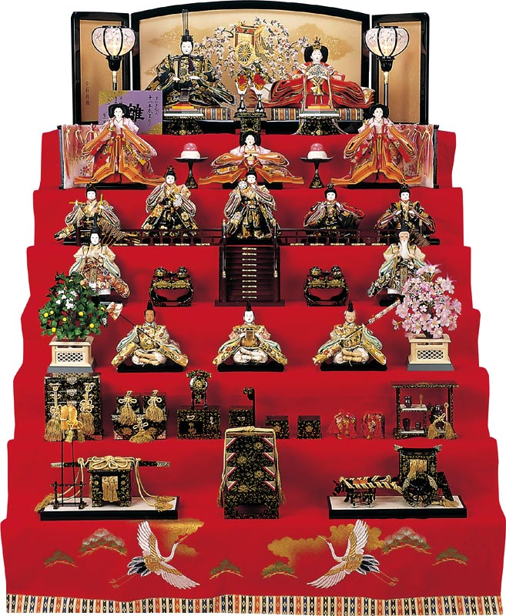
The dolls wear costumes of the imperial court during the Heian period (794-1192) and are placed on a tiered platform covered with red felt. The size of the dolls and number of steps vary, but usually the displays are of five or seven layers; single-tiered decorations with one male and one female doll are also common. The top tier is reserved for the emperor and the empress. A miniature gilded folding screen is placed behind them, just like the real Imperial throne of the ancient court. On the second tier are three ladies-in-waiting, and on the third are five male court musicians. Ministers sit on either side of trays of food on the fourth step, and the fifth row features guards flanked by an orange tree to the left and a cherry tree to the right.
(http://web-japan.org/)

Slide 5
ダイアローグ

Slide 6
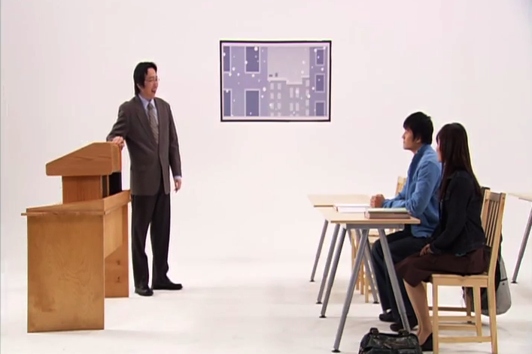
P187 ダイアローグ
「寒いですね。」
たしかに (certainly)
いつもより (than usual)
いやだなあ (unpleasant)
みんな風邪（かぜ）ひかないように
気（き）をつける
(Everybody take care so that you don’t catch cold.)

Slide 7
P187 ダイアローグ
きいてください。

Slide 8
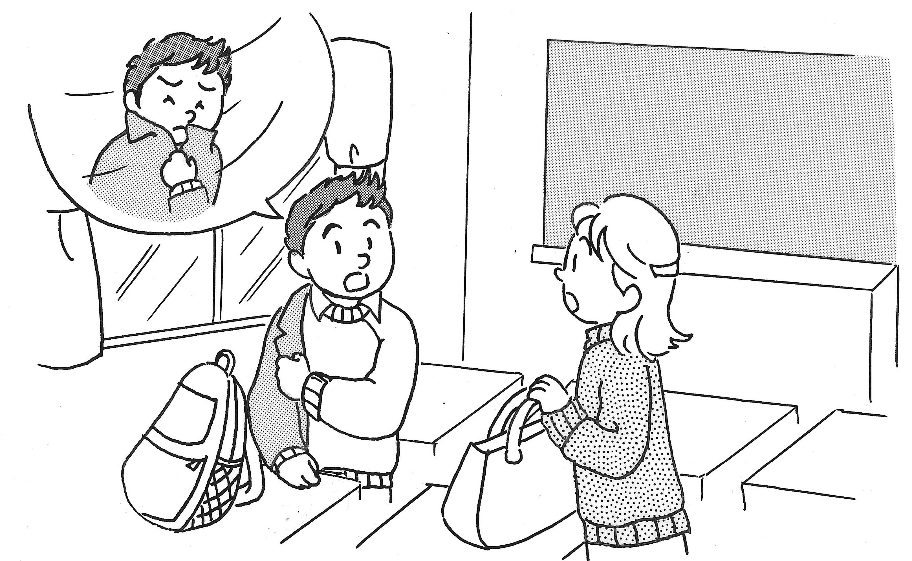
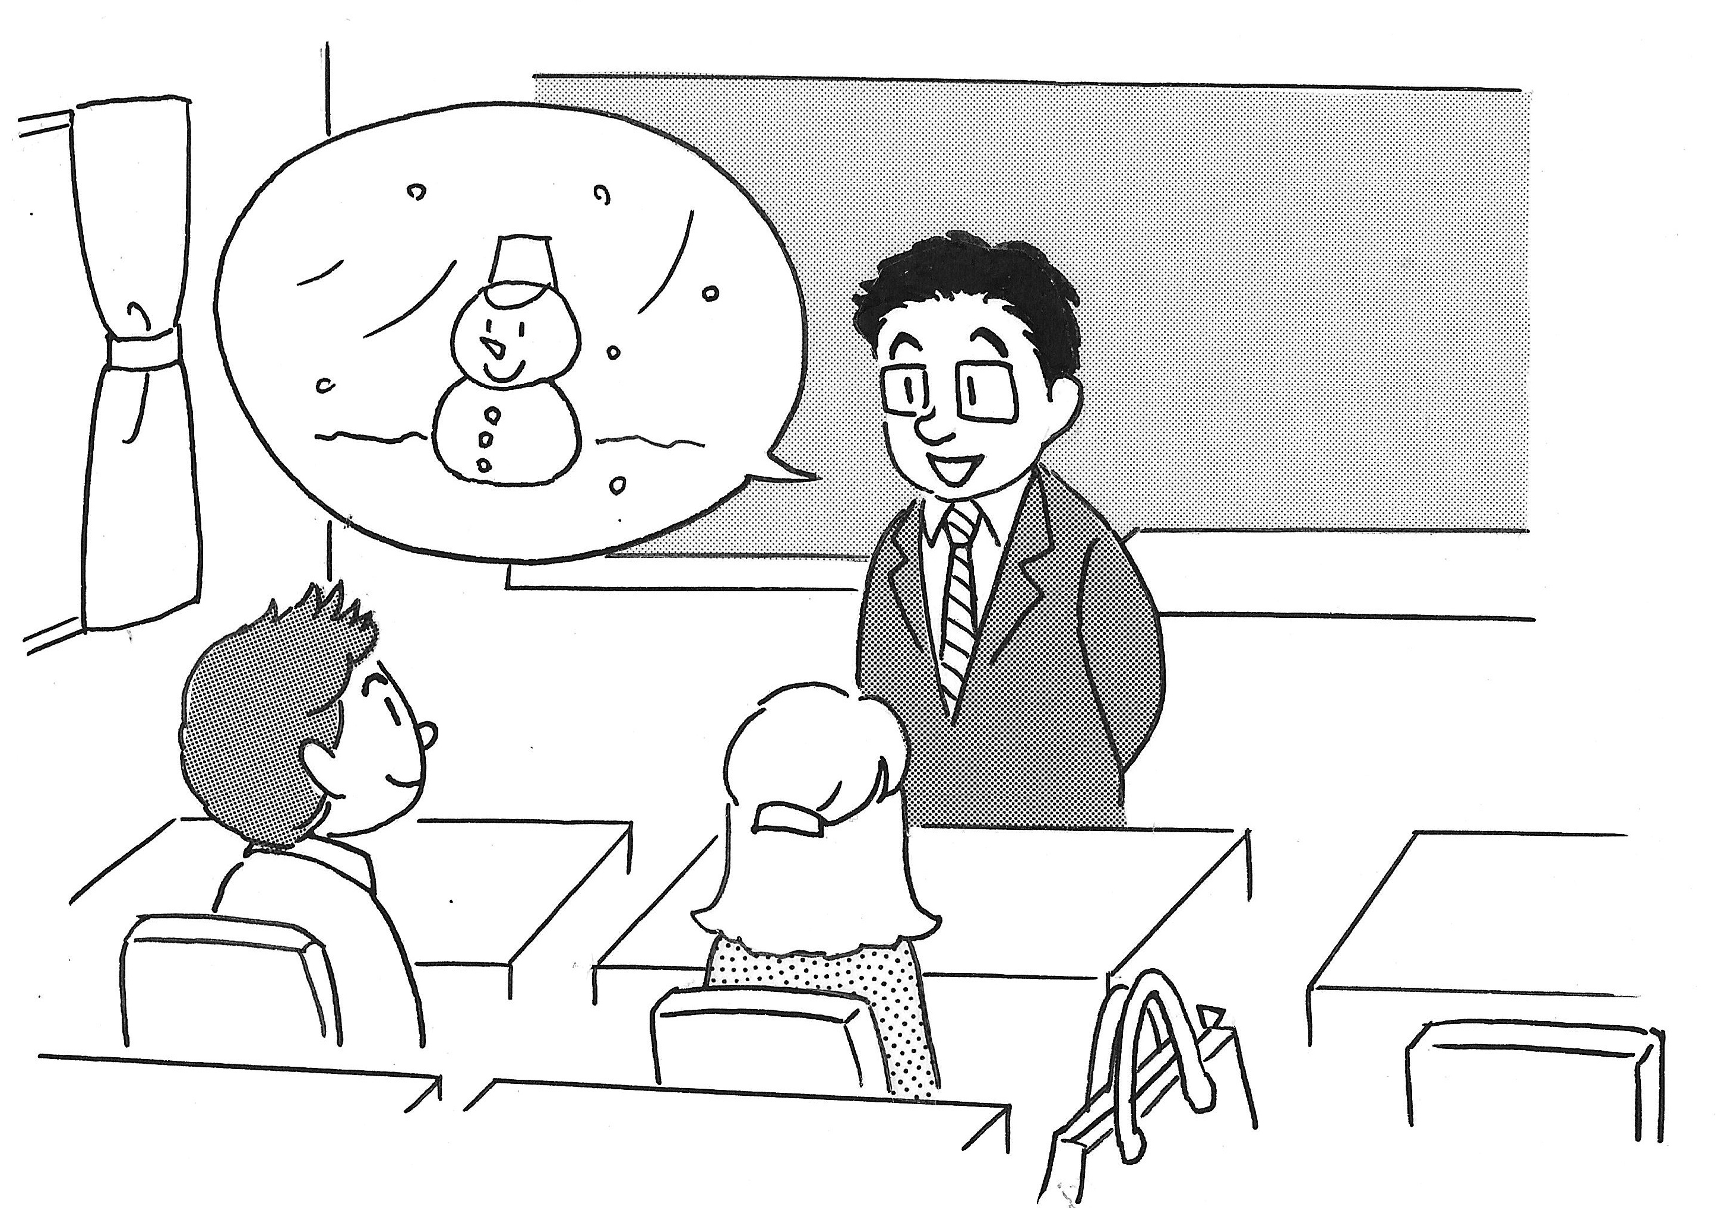
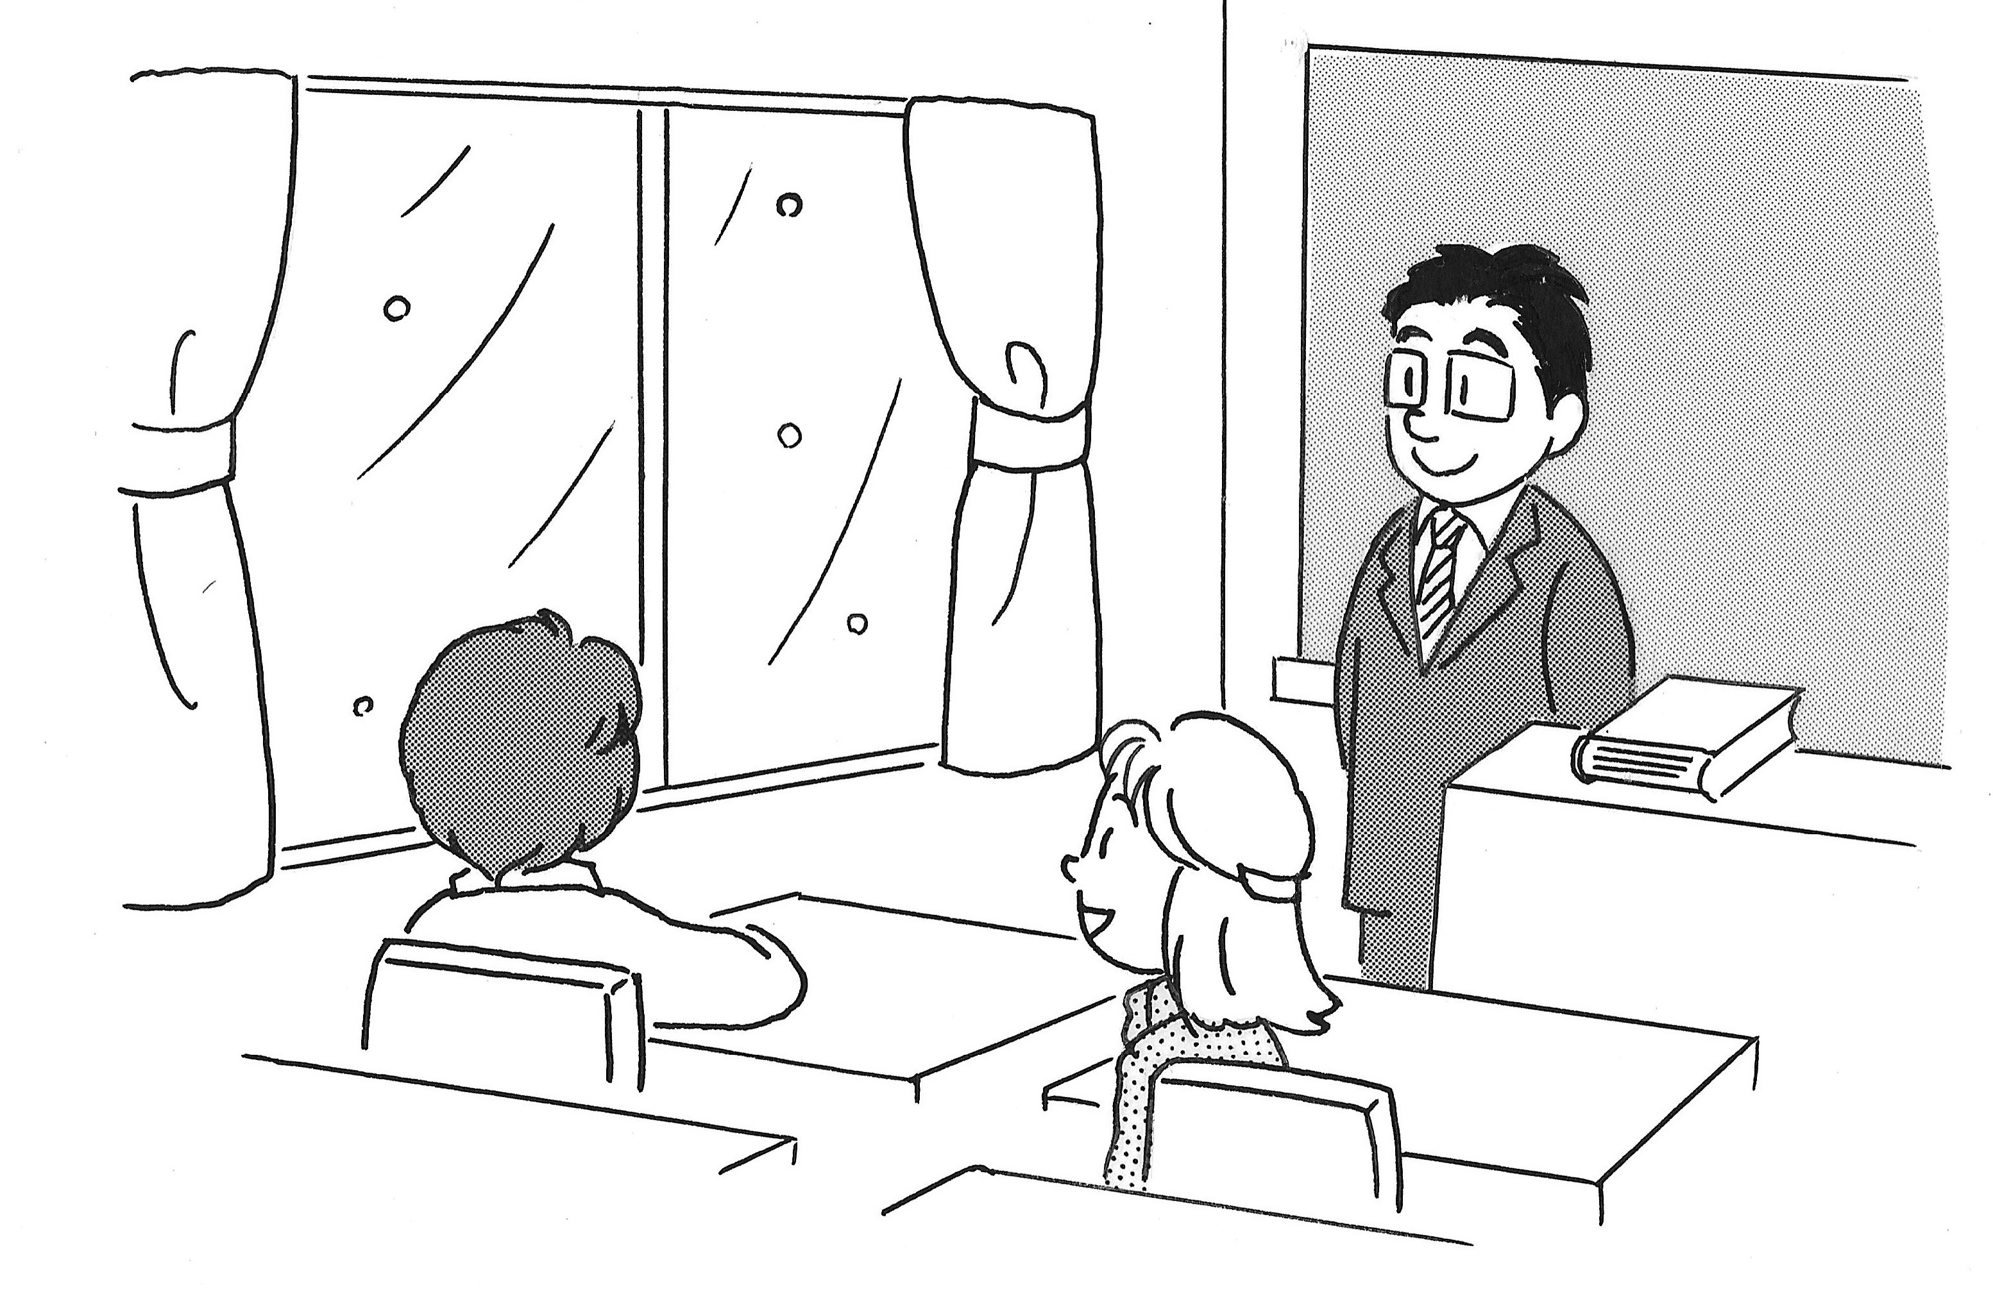
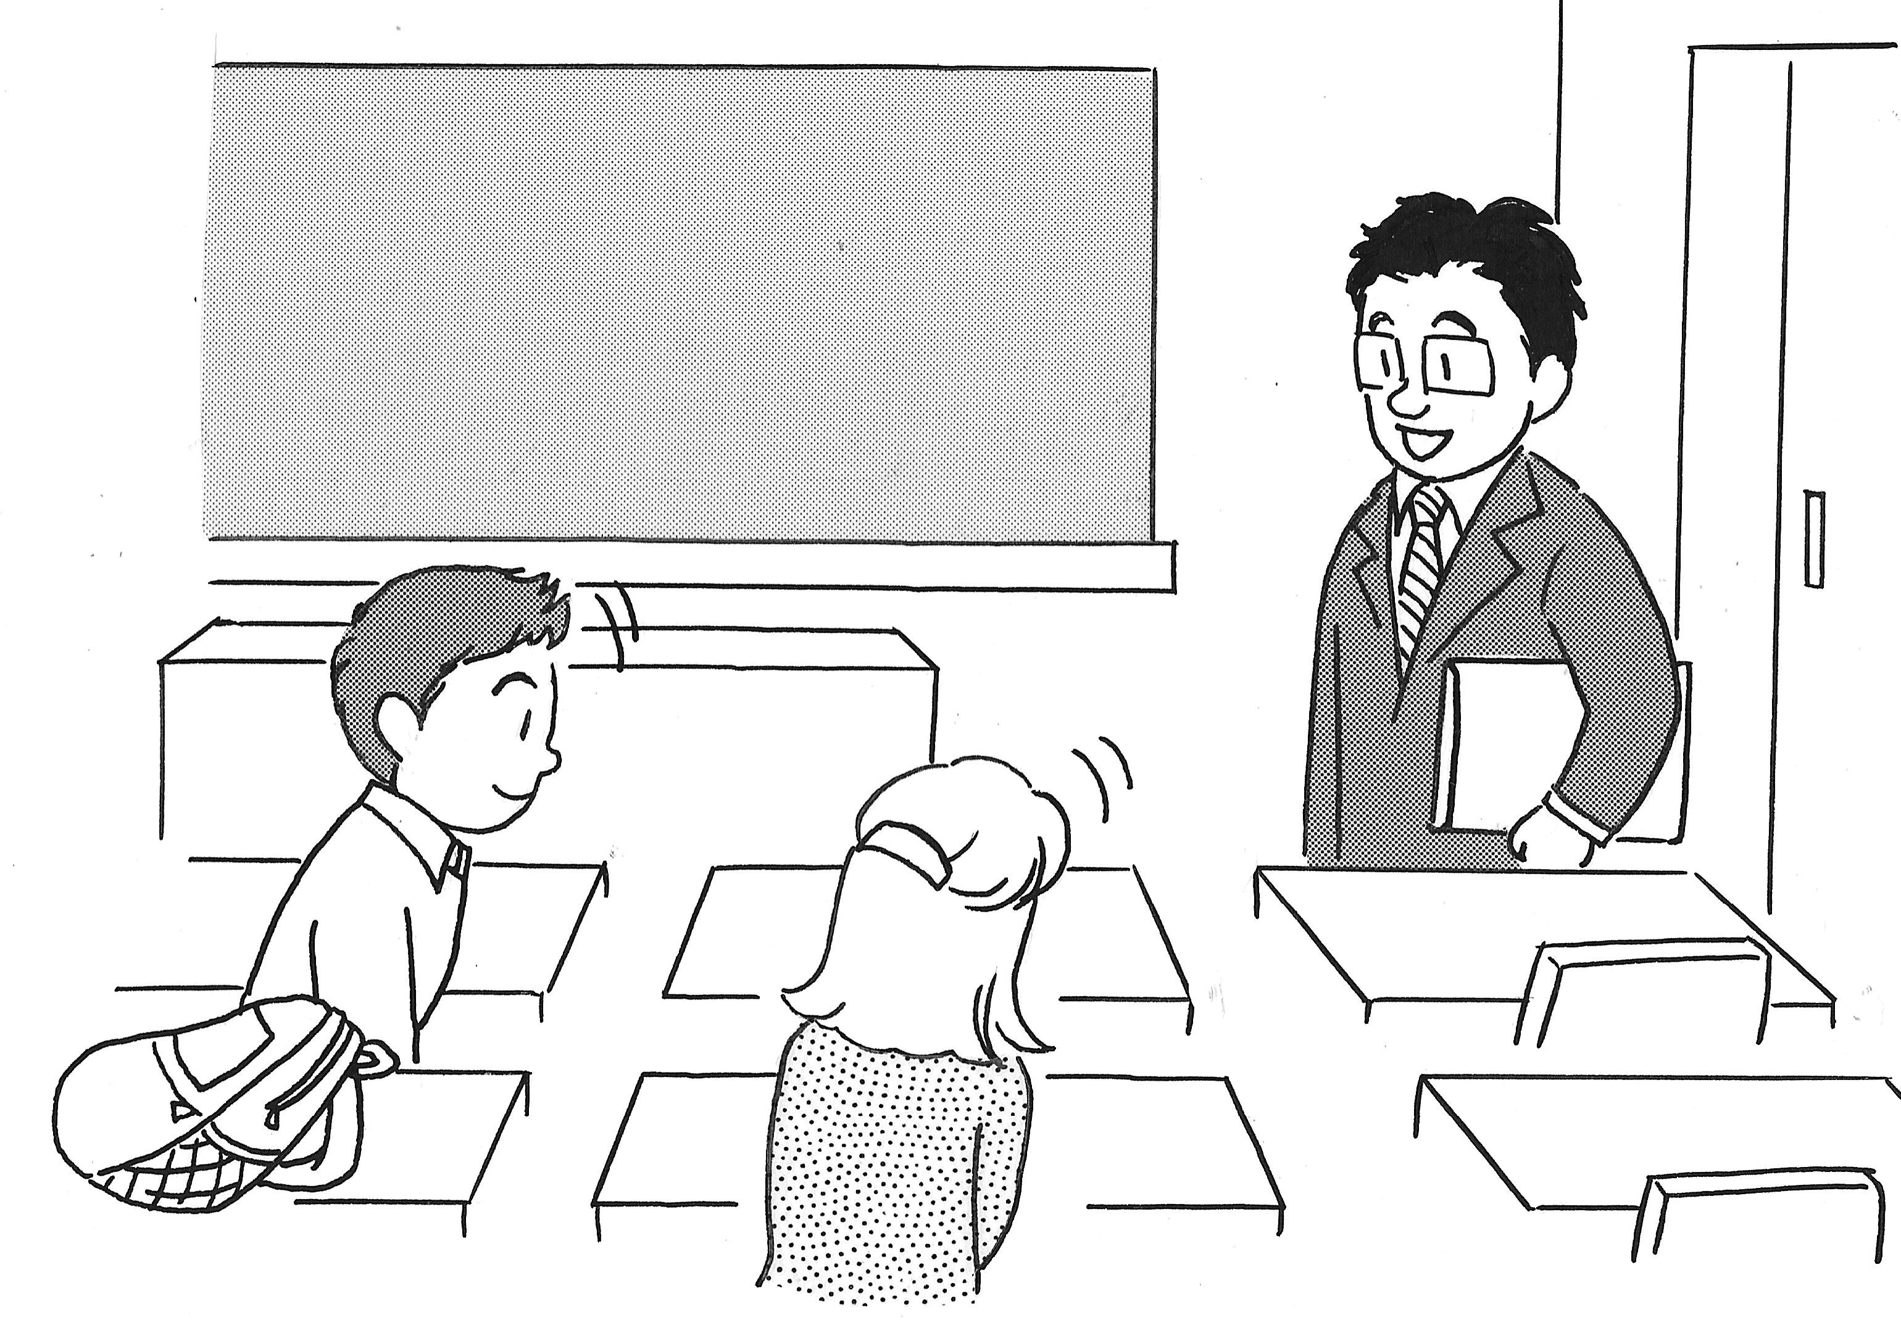
P188 ダイアローグ
1
3
A
B
4
2
C
D

Slide 9
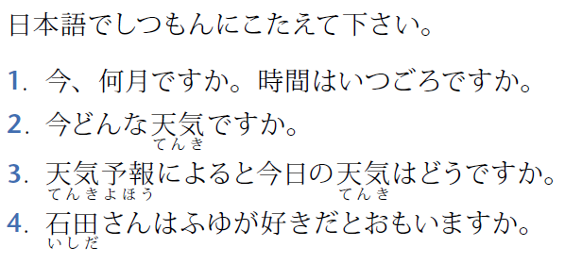
P189 ダイアローグの後で

Slide 10
P187 ダイアローグ

Slide 11
P187 ダイアローグ （じまく）

Slide 12
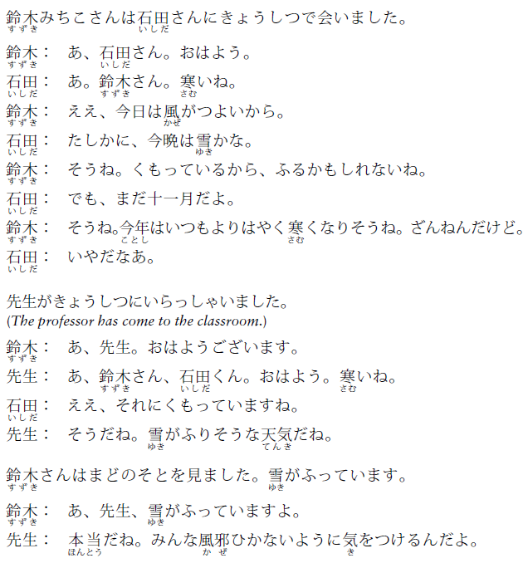

Slide 13
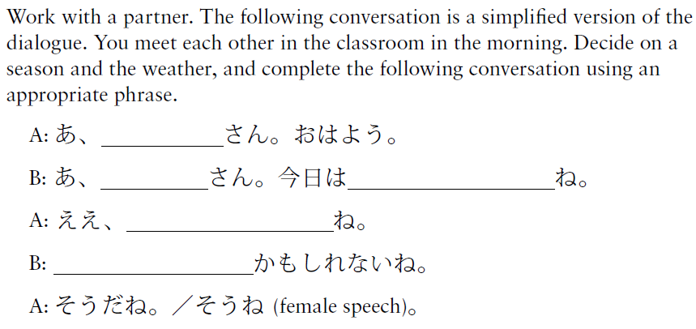
P189 ダイアローグの後で
いしだ
寒い
田中
雪がふりそう
うん、ふるかも

Slide 14
読むれんしゅう

Slide 15
P219 読むれんしゅう

Slide 16
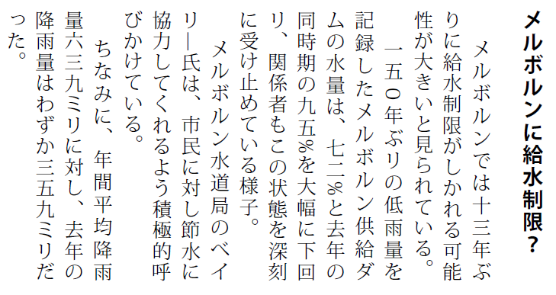
P219 読むれんしゅう

Slide 17
P219 読むれんしゅう
よこ書き
たて書き

Slide 18
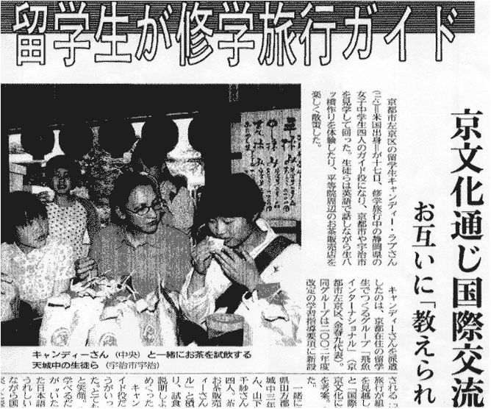
P219 読むれんしゅう
18

Slide 19
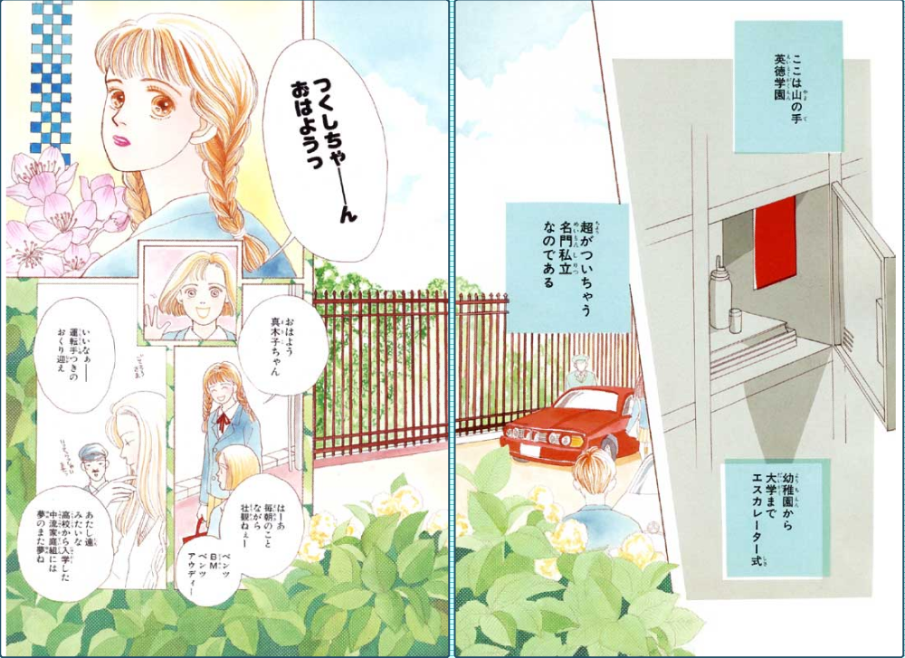
P219 読むれんしゅう

Slide 20
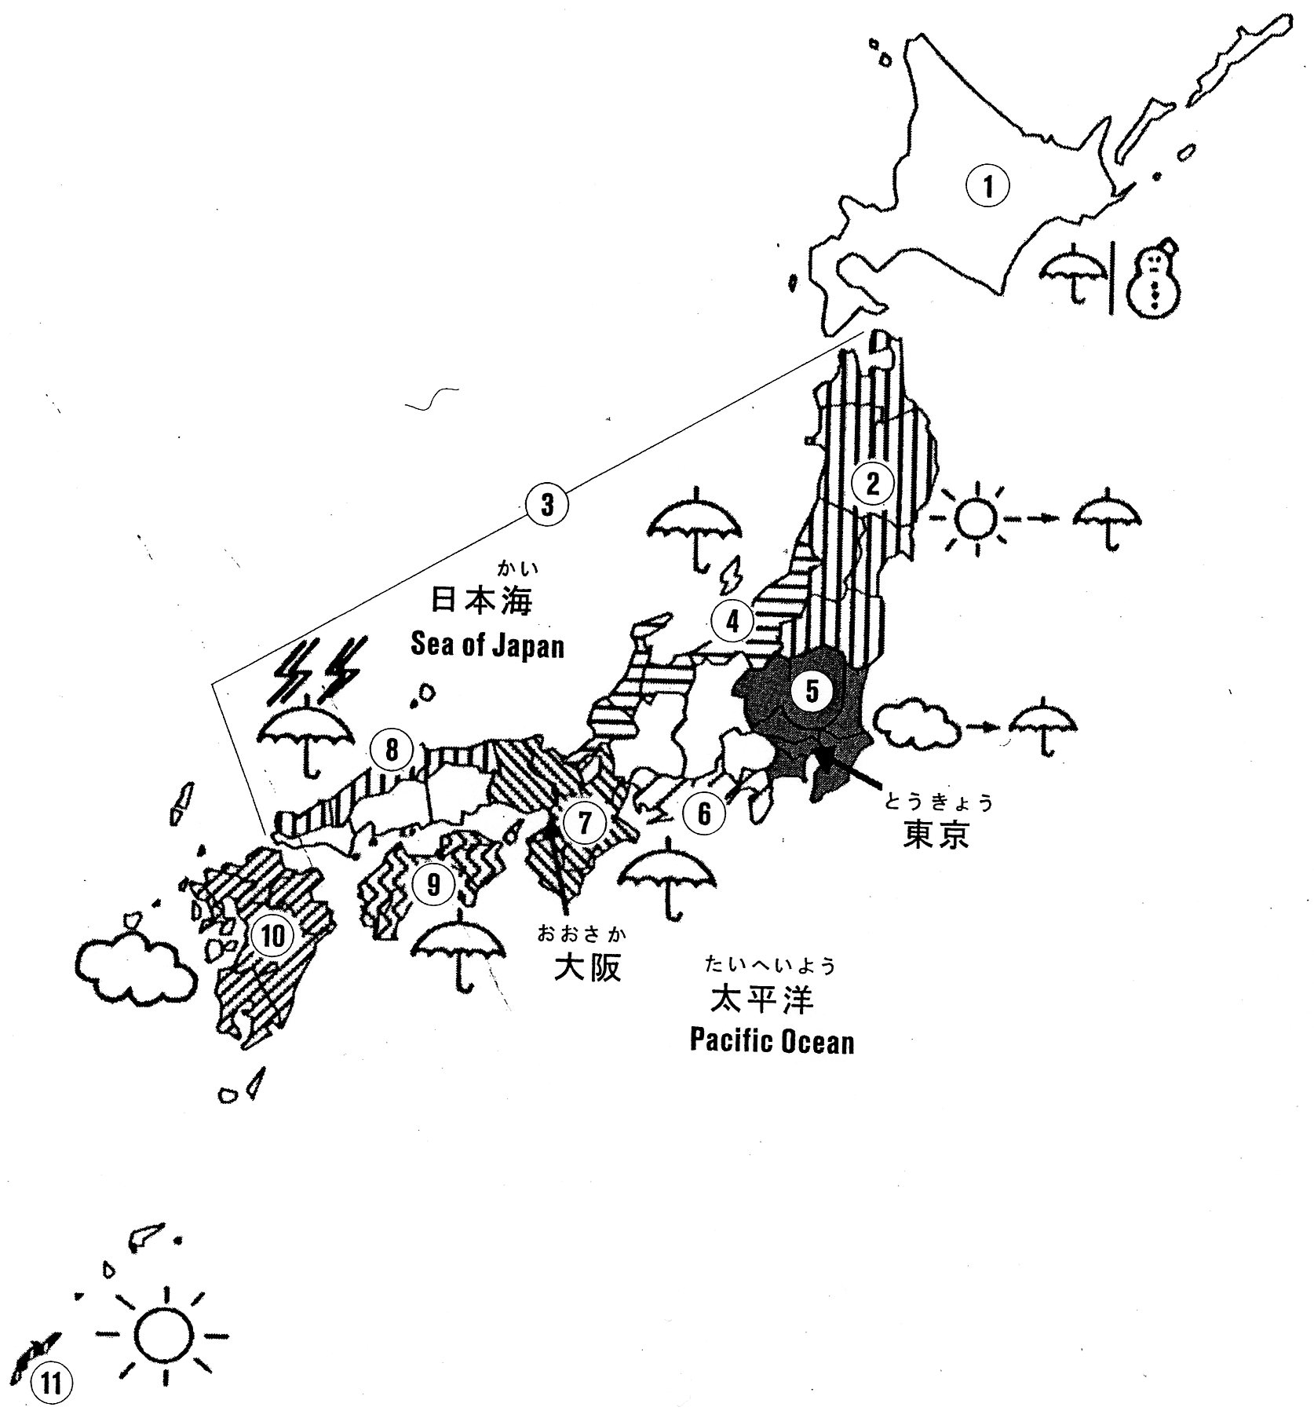
P220 読むれんしゅう
北海道
ほっかいどう
本州
ほんしゅう
九州
きゅうしゅう
四国
しこく

Slide 21
P220 読むれんしゅう
8
1
5
7
10
4
3
2
6
9

Slide 22
P221 読むれんしゅう

Slide 23
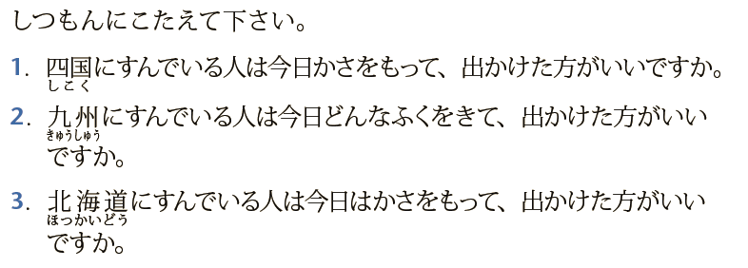
P221 読むれんしゅう

Slide 24
P221 読むれんしゅう

Slide 25
聞くれんしゅう

Slide 26
P214 聞くれんしゅう

Slide 27
P214 聞くれんしゅう
General description of national weather condition
Regional forecasts by areas
Each regional forecast contains specific information
(condition, high and low temperatures)
General comment

Slide 28
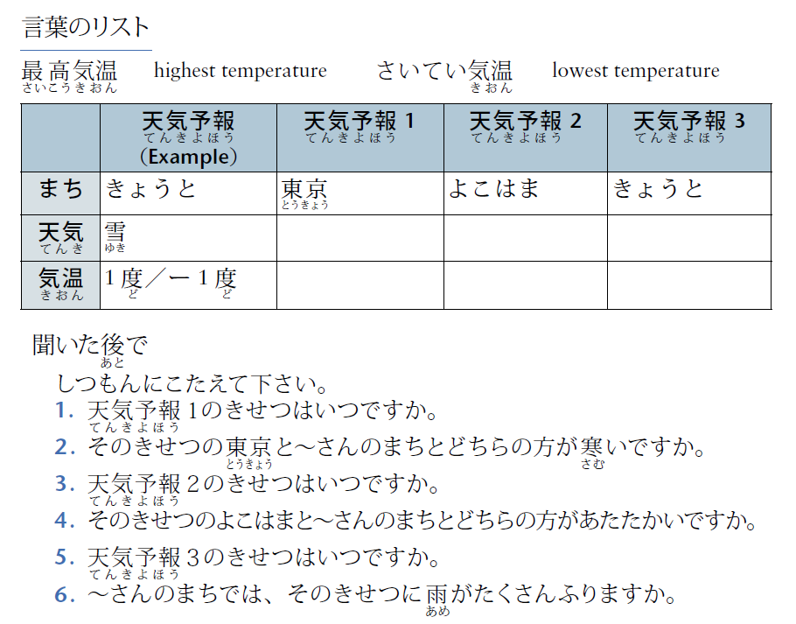
P214 聞くれんしゅう

